Slide 1
Introduction to Sensor Markup Language
Soumya Kanti Datta
Mobile Communications Department
Email: Soumya-Kanti.Datta@eurecom.fr

Slide 2
What is SenML?
SenML draft defines new media types for carrying simple sensor information in a protocol such as HTTP or CoAP.
It provides a structured and uniform mechanism to represent simple sensor measurement and device parameters.
Device parameters including
Name, ID, type, unit, timestamp, software version…
Implementation
JSON / EXI / XML

Slide 3
Motivation
Constrained devices could easily encode a sensor measurement into the media type (application/senml+json).
M2M server parsing the data could relatively efficiently collect a large number of sensor measurements.

Slide 4
Data Model
The data is structured as a single object (with attributes) that contains an array of entries.
Each entry is an object that has attributes such as a unique identifier for the sensor, the time the measurement was made, and the current value.
Serializations of the data model are defined for JSON, XML and EXI.

Slide 5
Semantics
Base name
Base time
Base unit
Version
Name
Value
Unit
Time

Slide 6
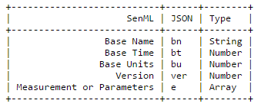
JSON Representation: Root Variables

Slide 7
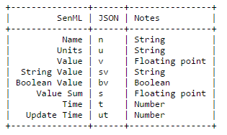
Measurement Entries

Slide 8
Examples: Single Measurement
{"e":[{ "n": "urn:dev:ow:10e2073a01080063", "v":23.5 }]}
a temperature reading taken approximately "now" by a 1-wire sensor device that was assigned the unique 1-wire address of 10e2073a01080063

Slide 9
Reading Materials
SenML draft - https://tools.ietf.org/html/draft-jennings-core-senml-00

Slide 10
Thank you!
Email: Soumya-Kanti.Datta@eurecom.fr
Webpage: http://www.eurecom.fr/en/people/datta-soumya-kanti/publications
Twitter: @skdatta2010

