Slide 1
Hardware Token Support for the Web
Analysis of the W3C Workshop on Authentication, Hardware Tokens and Beyond

Slide 2
Facts
Outcome of W3C Workshop on Authentication, Hardware Tokens and Beyond
Hardware tokens in scope (including Platform-held keys): unanimous support
Key Discovery: high support
  Device Discovery: high support
  Attestation of provenance: high support
  User-owned keys (aka individual-managed ID, aka FIDO): medium support
The gap between unanimous support and high support for hardware authentication vs. medium support for individual-managed ID (aka FIDO) is because there are several solutions today used in the web that are for centrally-issued IDs. At the workshop several governments and companies that are in the business of centrally-issued IDs were represented.
Both centrally-issued IDs and individual-managed IDs are equally important. One cannot replace the other.

Slide 3
Current state of hardware security
● Global Platform (GP) standard covers most of the interesting cases that support centrally-issued IDs
  ○ Smart cards
  ○ USIM cards
  ○ EMV cards
  ○ TPMs
  ○ TEEs
● There is substantial OS support for GP APIs (Windows, MacOS, Linux)
● Communications with the app use APDUs with standard framing, but app specific data
● The functions of a GP device are realized through “applications” resident on the device
● Each application has a unique, centrally registered AppID
● Each AppID belongs to a specific organization.

Slide 4
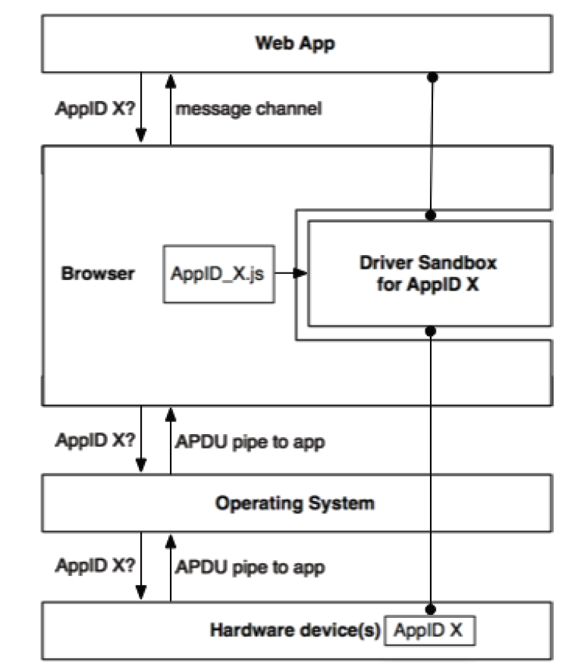
Proposal - Architecture
Supports BOTH centrally-issued & individual-managed IDs
● Create a specialized JS sandbox for accessing secure hardware
  ○ Two interfaces:
    ■ APDU interface to a specific AppID instance (on the secure h/w device)
    ■ Message channel to web app
  ○ For some set of AppIDs, the browser obtains a JS “driver” that the owner of the AppID authorizes to access instances of that AppID
    ■ Driver translates from JS messages/API to APDUs
    ■ Driver could be delivered through dynamic loading from the web
    (à la WebRTC IdP) or a more static plugin / addon framework
● Web app requests access to AppID X
  ○ Browser checks that it has a JS driver for AppID X
  ○ Browser determines whether there is a device present that has an app with
  AppID X
  ○ Browser obtains from the OS a way to pass APDUs to that app instance
  ○ Browser loads the JS driver into a sandbox with (1) the APDU interface
  connected to the app instance, and (2) a message channel to the web app
  ○ Browser passes message channel back to web app

Slide 5
Proposal
Why support both centrally-issued & individual-managed IDs?
Centrally-issued | Individual-managed
Billions of IDs already issued and have Global Platform as the common standard | New standard from FIDO
Necessary for Liability ownership | Necessary for privacy
Cannot provide privacy | Cannot provide liability or know your customer
Supporting individual-managed IDs only = medium support
Supporting both individual-managed IDs and centrally-issued IDs = unanimous support

