Slide 1
Proposal for the support of connected and proximity crypto HW in browsers
Presentation Title Slide
Philip Hoyer – Director Strategic Innovation
January 2015
An ASSA ABLOY Group brand
PROPRIETARY INFORMATION.
© 2012 HID Global Corporation. All rights reserved.

Slide 2
Consensus of W3C crypto workshop
replace passwords as quick as possible
Allow web application in the browser to access an API that would allow the proof of possessions of keys that are also held on hardware devices
Giving direct access to the APDU / comms is a bad idea (like giving raw socket access to a web page). One of the main concern was privacy (being able to track people by tracking Ids or PIIs on the cards)
Browser extensions are going so there needs to be a solution to use existing credentials
The level of abstraction is still unclear but the web app should have access to a similar level than the current web crypto API (sign, encrypt, decrypt, etc)

Slide 3
HID proposal
Requirements:
Very important to be able to support the millions of centrally issued IDs capable of being used for multiple origins / GlobalPlatform APDU based
Important to support SOP based HW tokens – FIDO (also APDU based on low layer)
Support for connected (SC, SIM, eSE, smart MicroSD, TEE) security tokens and tokens connected via NFC / BLE
No APDU channel based exposure to web app
Web app has access to discover and connect to tokens and communicate at high level API based on Webcrypto
Support for use cases beyond direct authentication (posession of key)
Sign, encrypt, potentially store and retrieve secure data, user approval (Out of band or approve / deny signing)

Slide 4
Proposal – HW token API: three layers
HW token API - Higher level API (uses Comm API) :
Discovery / Connection and listing of known Security tokens independent of transport (abstract connected vs NFC / BLE, etc as much as possible)
Retrieval of the security capabilities of known Security tokens
Connection API to the security devices at an abstraction level that would then map it to the existing W3C Crypto API Level (e.g. ability to retrieve a handle to a SubtleCrypto interface from a connected device handle)
Token API translation layer based on secure JS scripts run in browser sandbox retrieved from central trusted source by identifying the token / Application (using answer to reset / AIDs / FIDO attestation certificates …)
Potentially take as base: http://www.openscdp.org/
Communication oriented API, to be able to communicate with the HW token device from the translation script
Connected tokens – USB, SIMAlliance (SIM, eSE, Smart MicroSD)
NFC / BLE

Slide 5
Architecture

Slide 6
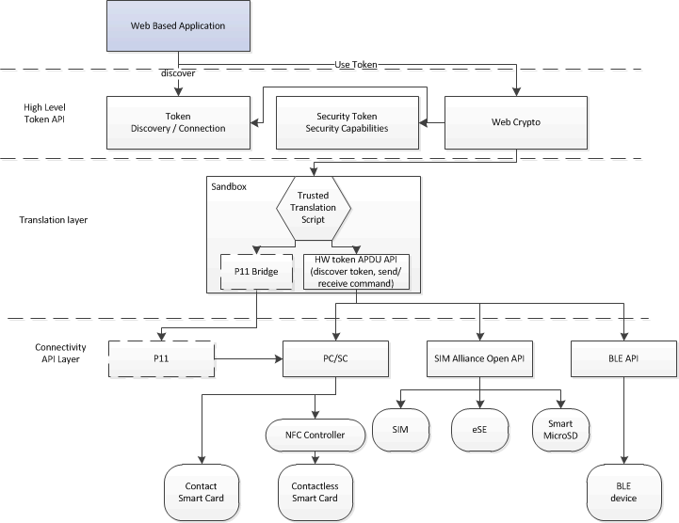
Layer diagram

Slide 7
To be explored
Privacy
Can we restrict which web app has access to which keys / token identifiers so not to track users across origins
NOTE: some centrally issued cross origin eIDs already have privacy features (e.g. German eID card, HID Seos card, etc)
By scoping the access of the API to the token itself the browser could prompt the user “www.acme.com wants to use your “Smart Card” token (not ideal)
Do we propose a CORS like standard to be put on the tokens/ devices?

Slide 8
Thank You Slide

