Slide 1

DRAFT
Social headlights task force:
DIAGRAMS, SCENARIOS, ...
Ann Bassetti
14 May 2012

Slide 2

Teams & contributors
Federated Social Web XG / Community Group
Social Business Community Group
Social Headlights Task Force
Particular thanks to:
Lloyd Fassett
Rich Rogers
David Robinson
Alberto Manuel
Blaine Cook
Ruinan Sun
Laurent Walter Goix
Virginie Galindo
Stéfane Fermigier
Evan Prodromou
Steve Holbrook
Harry Halpin
Jeff Jaffe
... apologies to anyone overlooked!

Slide 3
What we're doing
DRAFT
Seeking to determine:
Essential components of "social networking"
Relationships between parts
Characteristic scenarios and narratives
Basis set and tests
What technologies and standards exist?
Where was that work done?
Is more needed?
Should W3C play a role?

Slide 4
Jeff --my intention would be to blast through the evolution of the block diagram very quickly ... when shown to a large group they're 'eye charts' anyway. Mostly I want to show the evolution of our thinking and the various contributions.

Slide 5
What are essential components of
"social networking" or "social web"?
A question covering such a large area…
Methodology
  Criss-crossing the social web principles
  Listing all the components
  Classifying them
    Into groups, by standardization body, by technology
→ Here is the result …

Slide 6
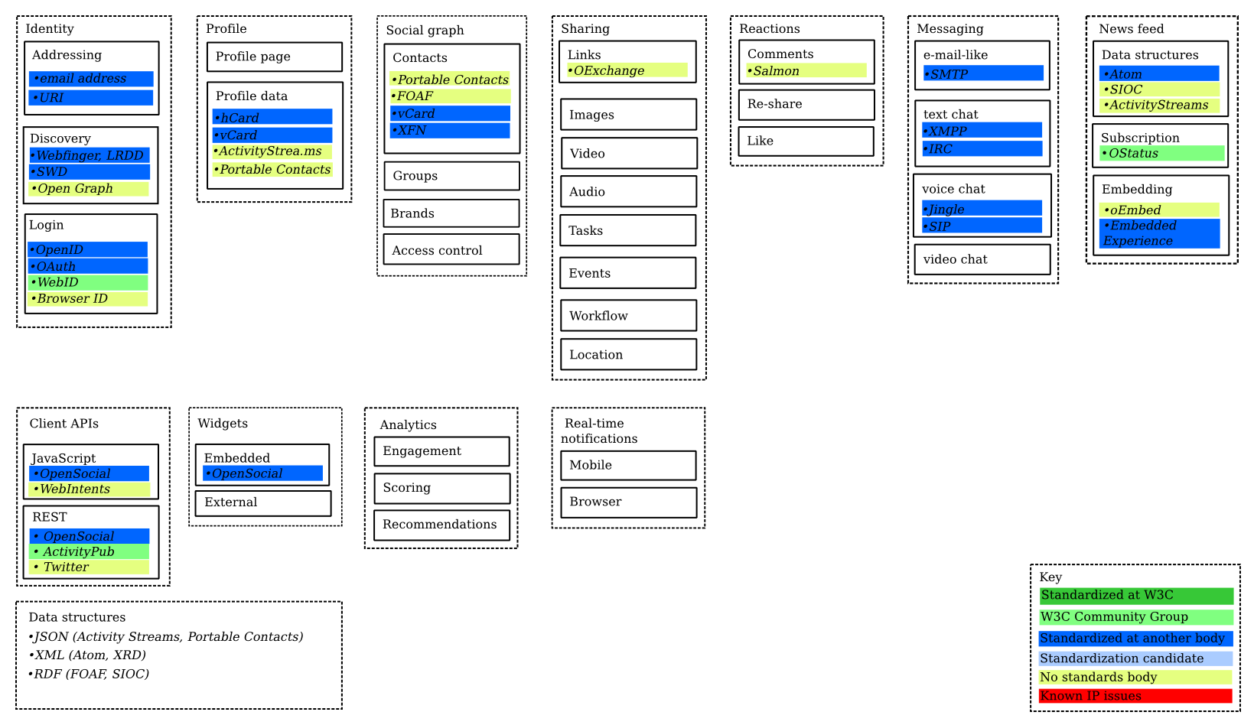
What are essential components of
"social networking" or "social web"?
DRAFT
Harry Halpin, Evan Prodromou
based on work in Federated Social Web group

Slide 7
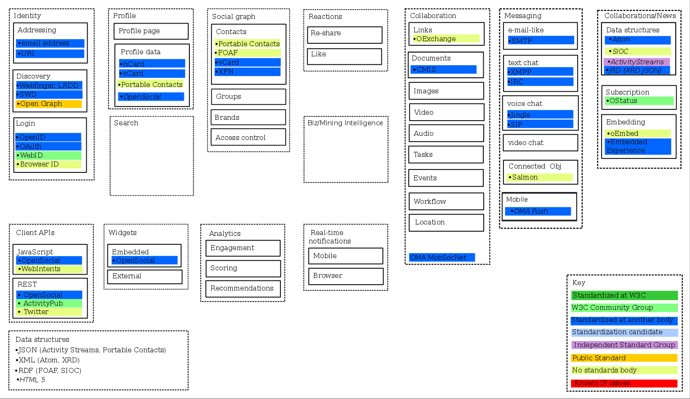
DRAFT
David Robinson additions
(annotations by Ann Bassetti)
was called 'news'
was called 'sharing'
moved "Activity Stteams" from here
*NOTE: needs to be checked to make sure I found all additions and changes

Slide 8
DRAFT
Human interactions
Ann Bassetti additions
Sharing
Messaging
Group Dynamics
(e.g., Community, Team)
Newsfeed
Reactions
Key
Standardized at W3C
W3C Community Group
Standardized at another body
Standardization candidate
No standards body
Known IP issues
Text
E-mail like
SMTP
Data structures
Atom
SIOC
ActivityStreams
Comments
Salmon
Links
OExchange
Create
Text chat (includes 1:1 and 1:multiple; also includes "Live Chat" such as with Helpline person)
XMPP
IRC
Re-share
Images
Join / Un-join
Subscription
OStatus
Video
End / Close
Like / rating
Audio
Membership list(s)
Embedding
oEmbed
Embedded Experience
Recommendations
Tasks
Voice chat
Jingle
STP
Group list(s)
Tags
Events
Distribution list(s)
About the human *
Alerts / Notifications
Workflow
Routing
Signatures
Video chat
Identity
Given/family name
Username(s)
Assigned number(s) (e.g., governmental)
....
Social Graph
Profile
Contacts
Portable Contacts
FOAF
vCard
XFN
Profile page ??
Forward / reply (might be part of others or part of 'Sharing")
Profile data
hCard
vCard
ActivityStrea.ms
Portable Contacts
...
Location
Ubiquitous attributes
Bookmarks
Threaded discussions (e.g., bulletin board; includes "Idea Generation / Jam")
Threading
Sorting (by 'likes', 'most recent',...)
Hyperlinks
Variable device display
Variable security settings
...
Groups
Status
Presence
Microblog
Addressing
snail mail address
email address
URI
Brands
Presence
Access control ??
Location
*Note: inside corporate firewall one has professional
profile, separate from one's personal profile.
Skills
Technical foundations
Client APIs
Widgets
Analytics
Real-time Notifications
Login credentials
OpenID
OAuth
WebID
Browser ID
Data structures
JSON (Activity Streams, Portable Contacts)
XML (Atom, XRD)
RDF (FOAF, SIOC)
JavaScript
OpenSocial
WebIntents
Embedded
OpenSocial
Engagement
Mobile
External
Scoring
Browser
REST
OpenSocial
ActivityPub
Twitter
Recommendations
Discovery
Webfinger, LRDD
SWD
Open Graph
Content 'structures'
Wiki
Blog
HTML+
Microblog
Trends

Slide 9
Human interactions
All contributions merged; no technologies
Sharing / Collaboration
Messaging
Group Dynamics
(e.g., Community, Team)
Collaboration / Newsfeed
Reactions
DRAFT
E-mail like
Comments
Text
Text chat (includes 1:1 and 1:multiple; also includes "Live Chat" such as with Helpline person)
Data structures
Re-share
Create
Document
Subscription
Like / rating
Links
Join / Un-join
Embedding
End / Close
Recommendations
Images
Voice chat
Alerts / Notifications
Tags
Video
Membership list(s)
Video chat
Group list(s)
Audio
Forward / reply (might be part of others or part of 'Sharing")
Tasks
Distribution list(s)
About the human *
Events
Identity
Given/family name
User name(s)
Assigned number(s) (e.g., governmental)
....
Social Graph
Profile
Workflow
Routing
Signatures
Connected objects
Contacts
Profile page ??
Mobile
Ubiquitous attributes
Groups
Profile data
Location
Threading
Sorting (by 'likes', 'most recent',...)
Hyperlinks
Variable device display
Variable security settings
Search
Biz/Mining Intelligence (??)
...
Brands
Presence
Bookmarks
Access control ??
Location
Status
Presence
Microblog
Addressing
snail mail address
email address
URI
Skills
Technical foundations
* Note: professional profile, inside corporate firewall,
is separate from one's personal profile.
Client APIs
Widgets
Analytics
Real-time Notifications
Login credentials
Data structures
Content
'structures'
Wiki
Blog
HTML+
Microblog
JavaScript
Embedded
Engagement
Mobile
Discovery
REST
External
Scoring
Browser
Recommendations
Trends

Slide 10
Adding technologies, standards, and who is doing. (Not complete)
DRAFT
Human interactions
Sharing / Collaboration
Messaging
Group Dynamics
(e.g., Community, Team)
Collaboration / Newsfeed
Reactions
Key
Standardized at W3C
W3C Community Group
Standardized at another body
Standardization candidate
Independent standard group
Public standard
No standards body
Known IP issues
E-mail like
SMTP
Comments
Salmon
Text
Create
Data structures
Atom
SIOC
ActivityStreams
JRD (XRD, JSON)
Document
CMIS
Text chat (includes 1:1 and 1:multiple; also "Live Chat" such as with Helpline person)
XMPP
IRC
Re-share
Join / Un-join
Links
OExchange
End / Close
Like / rating
Subscription
OStatus
Membership list(s)
Recommendations
Images
Group list(s)
Embedding
oEmbed
Embedded Experience
Video
Voice chat
Jingle
STP
Distribution list(s)
Audio
Tasks
Video chat
Alerts / Notifications
Events
Forward / reply (might be part of others or part of 'Sharing")
Workflow
Routing
Signatures
Threaded discussions (e.g., bulletin board; includes "Idea Generation / Jam")
Location
Bookmarks
Status
Presence
Microblog
Connected objects
Salmon
OMA MobSocNet
Mobile
OMA Push

Slide 11
Adding technologies, standards, and who is doing. (Not complete)
DRAFT
Key
Standardized at W3C
W3C Community Group
Standardized at another body
Standardization candidate
Independent standard group
Public standard
No standards body
Known IP issues
About the human *
Identity
Given/family name
User name(s)
Assigned number(s) (e.g., governmental)
....
Social Graph
Profile
Contacts
Portable Contacts
FOAF
vCard
XFN
Profile page ??
Profile data
hCard
vCard
ActivityStreams
Portable Contacts
OpenSocial
Groups
Addressing
snail mail address
email address
URI
Brands
Presence
Access control ??
Location
*Note: inside corporate firewall one has professional
profile, separate from one's personal profile.
Skills

Slide 12
Adding technologies, standards, and who is doing. (Not complete)
DRAFT
Key
Standardized at W3C
W3C Community Group
Standardized at another body
Standardization candidate
Independent standard group
Public standard
No standards body
Known IP issues
Technical foundations
Client APIs
Widgets
Analytics
Real-time Notifications
Login credentials
OpenID
OAuth
WebID
Browser ID
Data structures
JSON
  Activity Streams
  Portable Contacts
XML
Atom
XRD
RDF
  FOAF
  SIOC
HTML5
Content
'structures'
Wiki
Blog
HTML+
Microblog
JavaScript
Embedded
Engagement
Mobile
REST
External
Scoring
Browser
Recommendations
Discovery
Webfinger, LRDD
SWD
Open Graph
Trends

Slide 13
Adding technologies, standards, and who is doing. (Not complete)
DRAFT
Key
Standardized at W3C
W3C Community Group
Standardized at another body
Standardization candidate
Independent standard group
Public standard
No standards body
Known IP issues
Ubiquitous attributes
Threading
Sorting (by 'likes', 'most recent',...)
Hyperlinks
Variable device display
Variable security settings
Search
Biz/Mining Intelligence (??)
...

Slide 14
What are essential components of
"social networking" or "social web"?
Once describing the social web components by categories, making sure everything is there…
  Human interaction
  About the human
  Ubiquitous attributes
  Technical foundations
You may want to organize items in a different way
  to identify the Basis Set
→ Here are the layers…

Slide 15
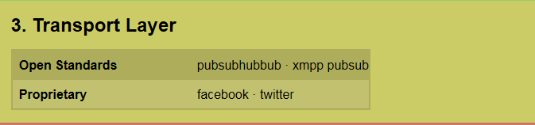
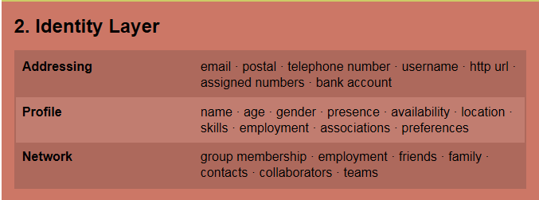
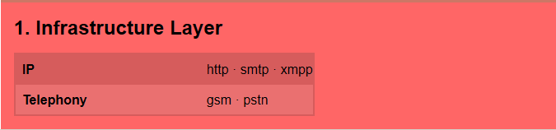
Blaine Cook "Layer" view. (Not complete.)
DRAFT

Slide 16
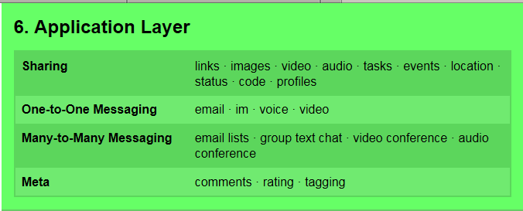

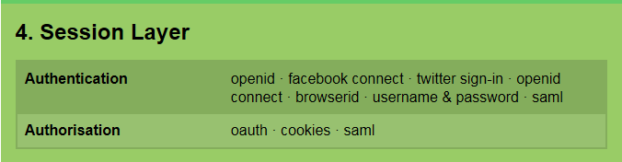
Blaine Cook "Layer" view, continued. (Not complete.)
DRAFT
(lots here; not finished)

Slide 17
Scenarios and narratives
DRAFT
Scenarios are the activities that drive the diagram.
What is the canonical set of social networking scenarios? Examples:
  Update personal information
  Explore a social graph
  Share information
  Provide a reaction
  ...
Can we write narratives to describe each scenario?
  Samples:
    http://www.w3.org/wiki/SocialWebHeadlightsTaskForce

Slide 18
Basis set and tests
DRAFT
"Basis Set" = the irreducible list of 5-10 components that are the top-level description of the block diagram
  Example: in the OSI model, the basis set is 7 layers
How to test if we have the correct Basis Set:
If, every time we describe a scenario, it uses the basis set, then we have correctly described the underlying technology.
  Example: With data communications, every time a message is sent, it goes through the 7 layers in approximately the same way.

Slide 19
DRAFT
Questions?
Reactions?
Suggestions?
Want to help?

Slide 20
Jeff -- seems like the next 2 charts should go in your presentation about Harry's ideas, rather than here.
I left them here, in case you want to grab them.

Slide 21
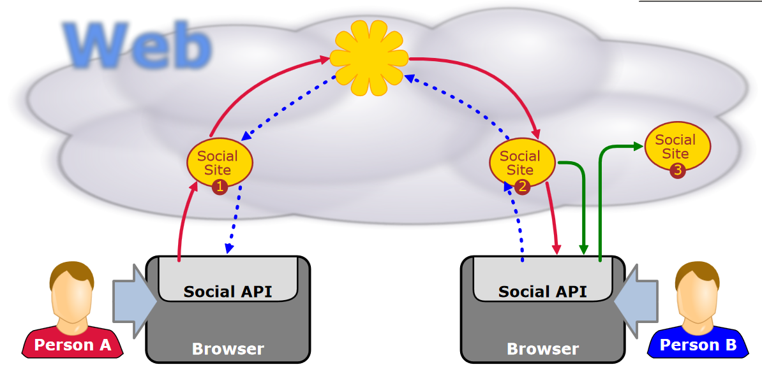
xyz

Slide 22
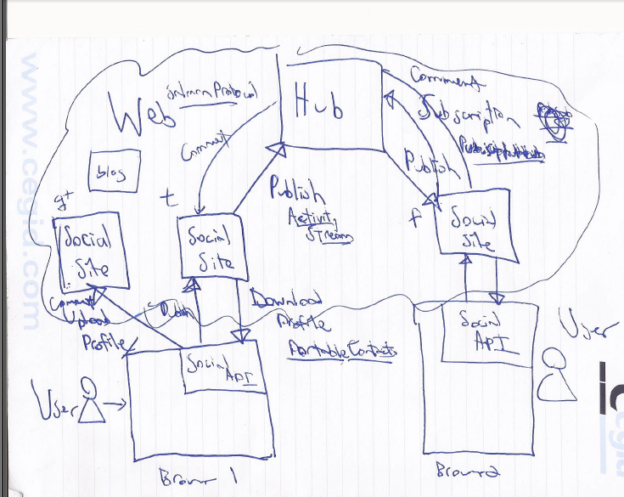
xyz

