Slide 1
Accessibility for EPUB and the Open Web Platform
Presentation at London Book Fair Acessibility Seminar
16 March 2017
Bill McCoy, W3C

Slide 2
About W3C: “Leading the Web to its Full Potential”
Founded 1994, now 400+ organization members
W3C standards include HTML, CSS, SVG, MathML XML, XSL-FO, XSLT, …
70+ staff in US (MIT), China (Beihang), France (ERCIM) and Japan (Keio)
Focus on advancing the overall Open Web Platform, as well as meeting specific industry requirements
International Digital Publishing Forum (IDPF) merged into W3C in February, 2017 - EPUB ongoing development is now under W3C
Tim Berners-Lee
WEB INVENTOR AND
W3C DIRECTOR

Slide 3
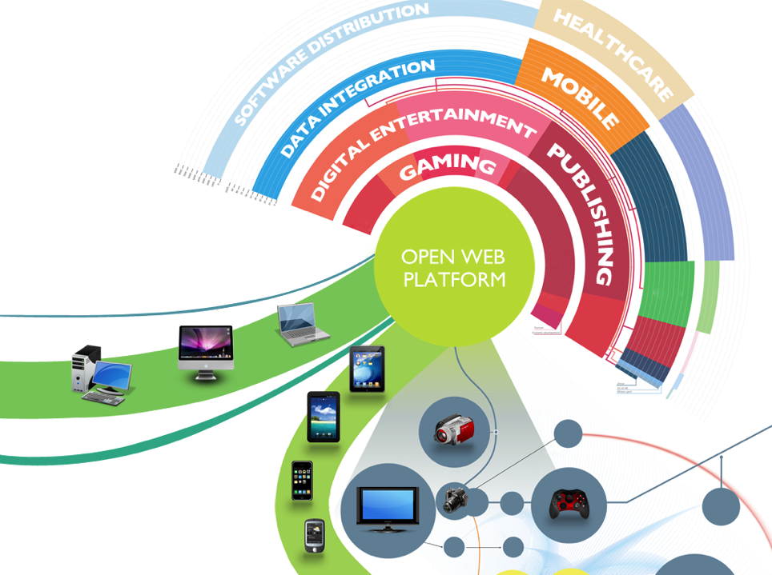
The Universal Content and Experience Platform
For all types of content, data, and experiences…
…on every device

Slide 4
Publishing@W3C Strategy +
Continue to develop and promote EPUB as the packaged accessible interchange and delivery format for digital publications
Continue to advance the overall Open Web platform to meet publishing industry needs
Pursue an ambitious vision to realize fully Web-native Web Publications: online/offline, packaged/distributed, browser/app

Slide 5
Web Accessibility
WCAG (Web Content Accessibility Guidelines) – rich suite of documentation and resources, WCAG 2.0 globally adopted
WAI-ARIA (Accessible Rich Internet Applications) – adds semantics to user interfaces via @role and @aria-*
Accessibility is one of the key horizontal review criteria for ALL proposed W3C Standards (along with security and internationalization)

Slide 6
Building Blocks of EPUB Accessibility
Structural semantics at content level (HTML) and publication level (machine-readable navigation, logical reading order, …)
Discovery and capability enablement via accessibility metadata at publication and content levels
Accessibility features such as Media Overlays and TTS hints

Slide 7
EPUB Accessibility 1.0: EPUB Accessibility Conformance and Discovery
First-class component of EPUB 3.1 (approved January, 2017 as final IDPF Recommended Specification)
Accessibility aspects of EPUB gathered in one document, with the bar raised to a higher level of expected conformance
Architected so as to be able to be enhanced independently and applicable earlier and future EPUB revisions
http://www.idpf.org/epub/a11y

Slide 8
EPUB Accessibility Conformance and Discovery
Built on W3C WCAG 2.0, with added requirements specific to publications
Discovery – enhanced accessibility & certification metadata with categories of accessibility compliance (“Discovery-enabled”, “Accessible”, “Optimized”)
Optimized Publications (publications that are optimized for a specific user group, for example, audio and Braille books)

Slide 9
Convergence Vision: Portable Web Publications
Publications on the Web, and packaged for offline use, share a fully unified technical architecture in which the same tools and techniques are applicable
Publishing requirements are fully and consistently supported throughout the Open Web Platform for packaged publications as well as online Web pages

Slide 10
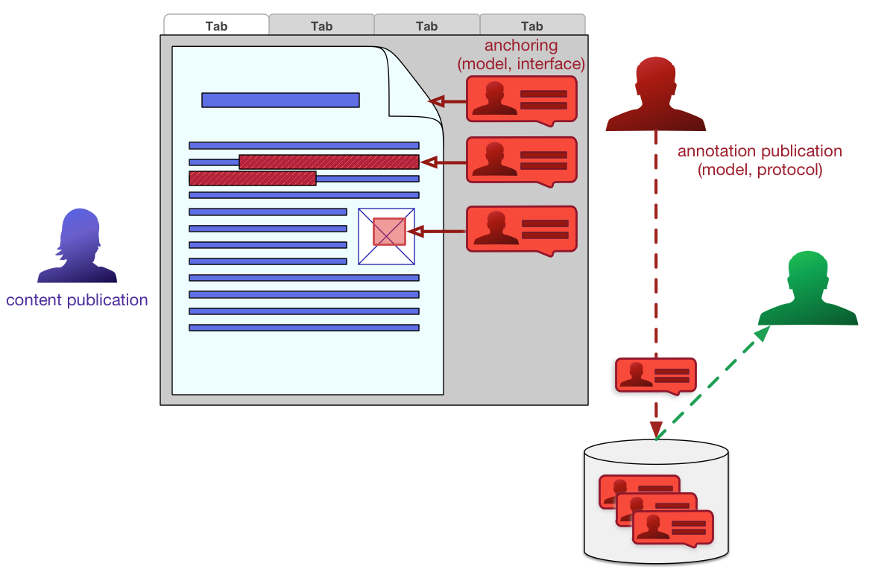
W3C Web Annotations

Slide 11
Publishing@W3C 2017 Focus Areas
Build community (upcoming: Publishing@W3C Summit Nov 8-9 San Francisco)
Accelerate EPUB 3 adoption via increased visibility and W3C “megaphone”
Continue to advance Web for publishing needs (see: https://www.w3.org/TR/dpub-css-priorities/, https://www.w3.org/TR/dpub-accessibility/ , https://www.w3.org/TR/dpub-aria-1.0/ )
Refine roadmap for the fully converged future (see: https://www.w3.org/TR/pwp/) and begin executing on it (see: https://w3c.github.io/dpubwg-charter/ )

Slide 12
Publishing@W3C Groups
Publishing Business Group
Strategy direction and requirements for Publishing@W3C
Oversight
Digital Publishing
Interest Group
Publishing
Working Group
(to be chartered)
EPUB 3
Community Group
Bridge building among communities
(may be closed in fall 2017)
Develop new Web Publications standards
EPUB 3.related technical activities
Diagram inspired by Murata Makoto

Slide 13
Publishing@W3C: Getting Involved
Type of Group | Group’s Focus, Scope | Eligibility | Fees
Transitional Publishing Industry (TPI) Membership | Participation in Publishing Business Group and new Publishing Working Group | Available to former IDPF members in good standing | Equal to former IDPF fees for first two years, based on revenue of organization
Publishing Business Group (PBG) | Strategic feedback between publishing industry and W3C. Shape new WG and oversee EPUB 3 CG | Open to any organization and to unaffiliated individuals | Small organizations, associations: $2K /year Large organizations: $10K /year
Regular W3C Membership | Participation in all W3C Business, Interest, and Working Groups | Open to any organization | Fees based on size of organization: start-up, affiliate, full and >$1Billion
EPUB 3 Community Group | Ongoing development of EPUB 3 specification family | Open to anyone | Free

Slide 14
Summary
EPUB and the overall Open Web Platform are foundations of accessible publishing
EPUB 3.1 is well-aligned with overall Web Accessibility initiatives and will continue to evolve and grow in adoption and mindshare under W3C stewardship
Future Web Publications functionality will further converge online/offline, packaged/distributed paradigms, with accessibility front and center in its driving requirements
There’s a lot more work to do to build on our successes and fully realize the goal that all publications and documents should be born accessible
W3C needs your help and engagement to lead accessible publishing to its full potential with the Web

Slide 15
Thank you
bmccoy@w3.org twitter: @billmccoy
http://w3.org/publishing http://w3.org/accessibility

