Slide 1
Interactivity & learning experience
Crispin Weston to W3C education group
6 February 2015

Slide 2
Summary of research

Taken together, the correlational and experimental evidence does not offer a convincing case for the general impact of digital technology on learning outcomes.
Impact of Digital Technology on Learning (EEF, 2012)


Slide 3
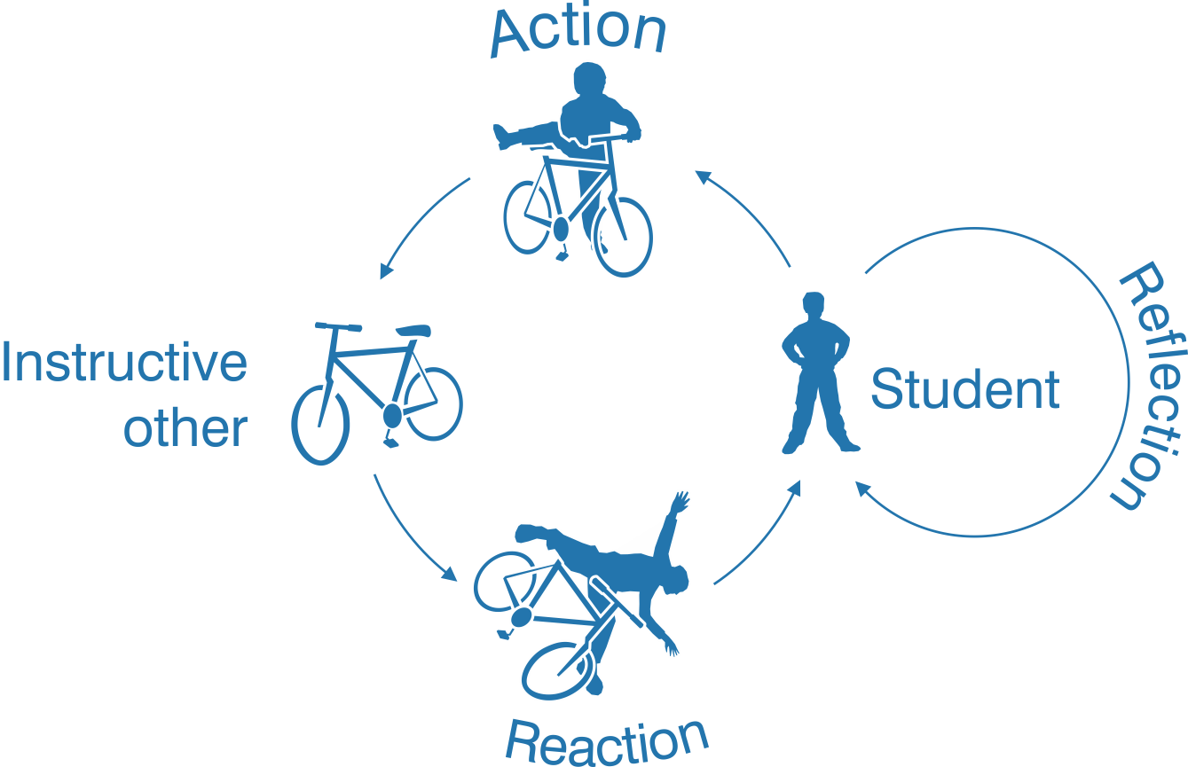
Learning through practice & feedback

Slide 4
Instructive others
Teacher
Peer
Environment or physical object
Digital simulations or facilitations of the above

Slide 5
Bloom’s taxonomy (or “gearing”)

Slide 6
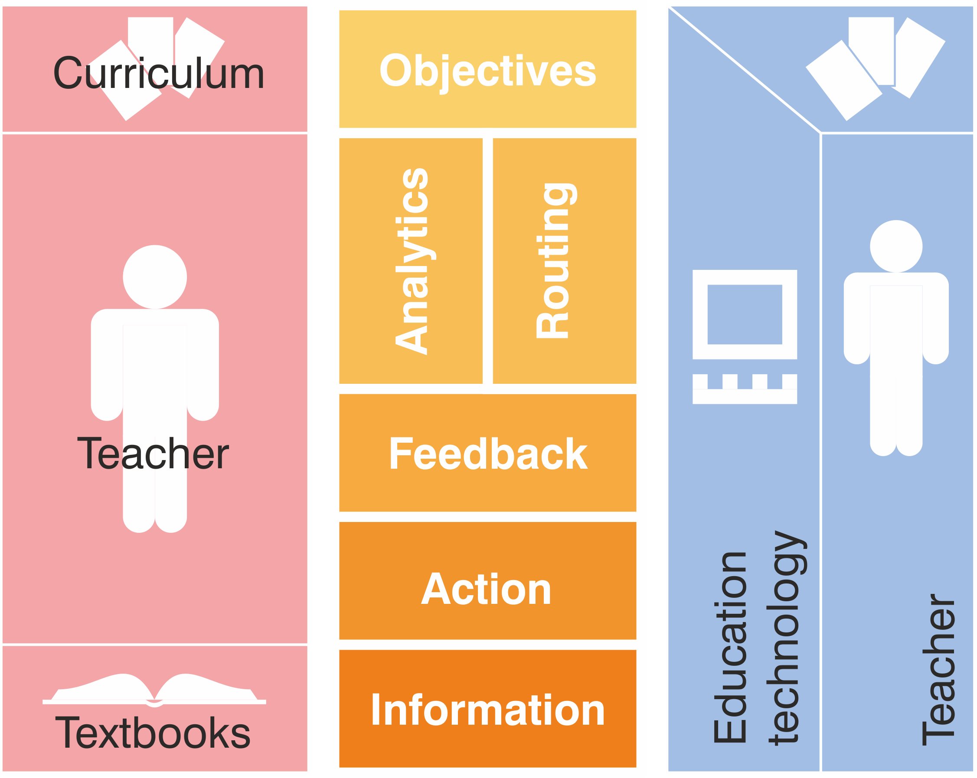
The instructional “stack”
Digital teaching
Traditional teaching

Slide 7
Learning activity & management

Slide 8
Pedagogy as activity sequencing

Slide 9
Complementary sequencing models

Slide 10
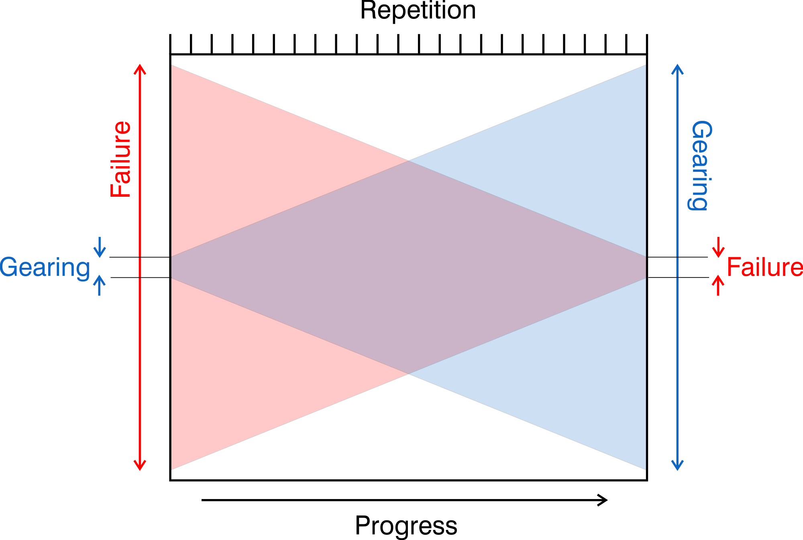
The assessment continuum

Slide 11
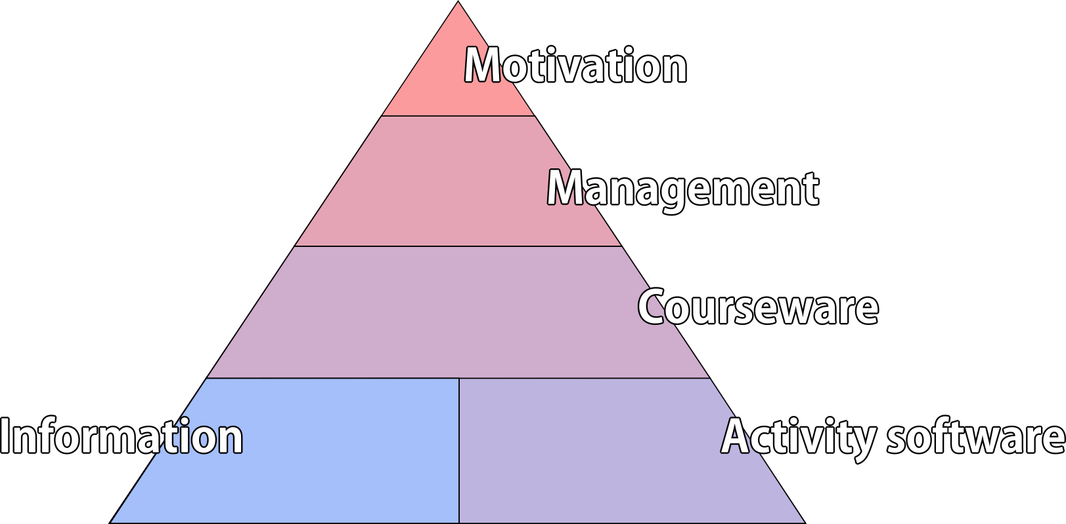
Ed-tech supply chain

Slide 12
Expressing learning objectives
invisible
visible

Slide 13
Abstract capabilities

Slide 14
Mixed structures

Slide 15
Mixed structures

Slide 16
Sources of uncertainty
In the assessment of performance
In the inference of capability
from performance
from capability
In the definition of capability

Slide 17
Moderation & marking automation

Slide 18
Reasons for failure of ed-tech to date
Lack of ed-tech!
Lack of learning management software
Lack of activity software
Lack of interoperability between the two
Lack of adaptability/reusability of activities
Lack of consensus on how to measure learning

Slide 19
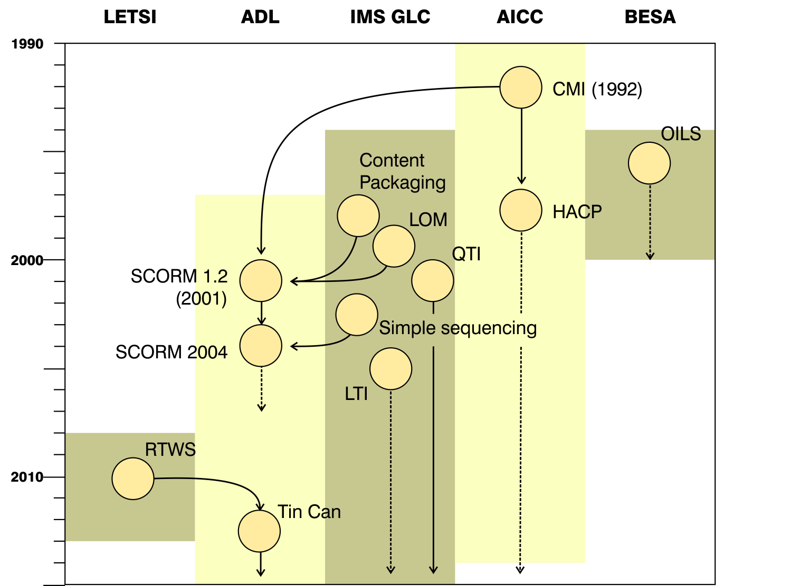
History of instructional standards
Does not include:
Enterprise data
Competency definitions
Textbook standards
Most metadata.

Slide 20
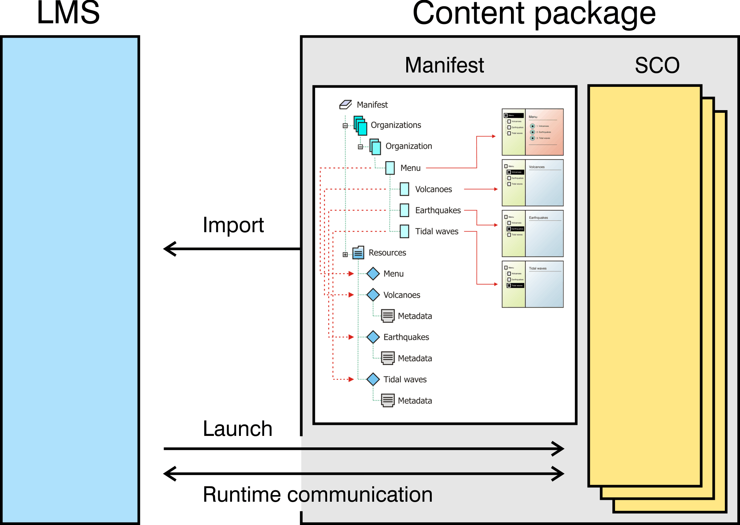
SCORM overview

Slide 21
Problems with SCORM
Legal disputes with IMS GLC
JavaScript API
Fixed data model
Poor sequencing specification
Little object reuse
Single learner model (no multi-player)
US DoD ownership

Slide 22
Tin Can / xAPI
Web Services transport layer
Simple triplet data-model + extensions
subject verb object [context] [result]
No launch
No metadata
No data model extension mechanism

Slide 23
My key standards issues
Updated SCORM-like reference standard with…
TinCan for runtime transport layer
“Multi-player” protocols
Data model definition language
Metadata
Launch parameters
Outcome reporting
Sequencing
Open scripting language
Black-box sequencing protocols
Describing & quantifying learning objectives
Data handling description language (for privacy)

