Slide 1
Introduction to W3C India Internationalisation Programme November 2017
1

Slide 2
W3C India Internationisation (i18n) Programme
W3C has launched an aggressive Internationalisation Program designed to identify and obtain the resources to significantly enhance and improve support for non-Latin languages on the Web.
Support for the major Indic Languages is a part of this program
The merger of IDPF with W3C has resulted in a set of activities called
The Indian Publishing community needs to bring their unique requirements to that conversation.

Slide 3
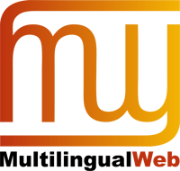
W3C and Internationalisation
W3C's mission is a Web for All, regardless of language, script or culture
W3C has provided tools to help with I18N for many years.
However, we need higher bandwidth discussions with leading website developers and language experts.
These conversations can inform us what today's major barriers are so we can conceive of new tools and language enablement.
Notes:
Ethnologue reports 7,100 languages currently spoken
Wikipedia reports 100 languages represent 85% of the world population
90+ languages are each spoken by 10+ million people

Slide 4
We welcome global participation in Publishing@W3C activities from any organization interested in joining the conversation about the future of publishing.
The Publishing Business Group fosters ongoing participation by members of the publishing industry and overall publishing ecosystem in the development of the Web for publishing, and serves as a conduit for feedback between the publishing ecosystem and W3C.
The mission of the Publishing Working Group is to enable all publications—with all their specificities and traditions—to become first-class entities on the Web.

Slide 5
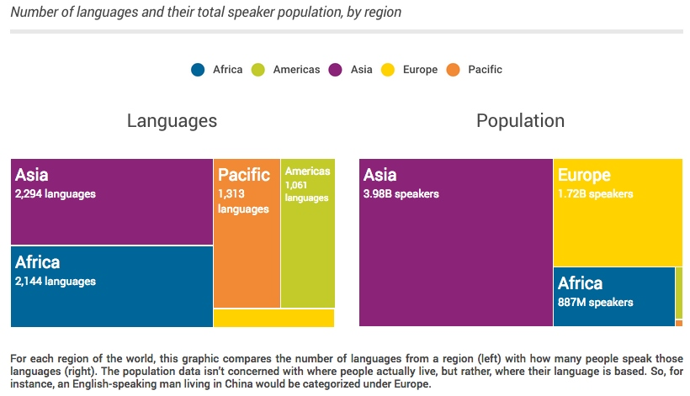
What is the I18N Current Landscape?
Ethnologue reports 7,100 languages currently spoken
Wikipedia reports 100 languages represent 85% of the world population
90+ languages are each spoken by 10+ million people
Simons, Gary F. and Charles D. Fennig (eds.). 2017. Ethnologue: Languages of the World, Twentieth edition

Slide 6
What does that look like in India?
Ethnologue reports 454 languages currently spoken in India
Wikipedia reports The 2001 census recorded 29 individual languages as having more than 1 million native speakers (0.1% of total population).
First, Second, and Third languages by number of speakers in India (2001 Census)
Language | First language speakers^{[9][10]} | First language speakers as a percentageof total population^{[11]} | Second language speakers^{[10]} | Third language speakers^{[10]} | Total speakers^{[12][10]} | Total speakers as apercentage of total population^{[11]}
Hindi^{[b]} | 422,048,642 | 41.03 | 98,207,180 | 31,160,696 | 551,416,518 | 53.60
Bengali | 83,369,769 | 8.10 | 6,637,222 | 1,108,088 | 91,115,079 | 8.86
Telugu | 74,002,856 | 7.19 | 9,723,626 | 1,266,019 | 84,992,501 | 8.26
Marathi | 71,936,894 | 6.99 | 9,546,414 | 2,701,498 | 84,184,806 | 8.18
Tamil | 60,793,814 | 5.91 | 4,992,253 | 956,335 | 66,742,402 | 6.49
Urdu | 51,536,111 | 5.01 | 6,535,489 | 1,007,912 | 59,079,512 | 5.74
Kannada | 37,924,011 | 3.69 | 11,455,287 | 1,396,428 | 50,775,726 | 4.94
Gujarati | 46,091,617 | 4.48 | 3,476,355 | 703,989 | 50,271,961 | 4.89
Odia | 33,017,446 | 3.21 | 3,272,151 | 319,525 | 36,609,122 | 3.56
Malayalam | 33,066,392 | 3.21 | 499,188 | 195,885 | 33,761,465 | 3.28
English | 226,449 | 0.02 | 86,125,221 | 38,993,066 | 125,344,736 | 12.18
Sanskrit | 14,135 | <0.01 | 1,234,931 | 3,742,223 | 4,991,289 | 0.49
Notes:
Ethnologue reports 7,100 languages currently spoken
Wikipedia reports 100 languages represent 85% of the world population
90+ languages are each spoken by 10+ million people

Slide 7
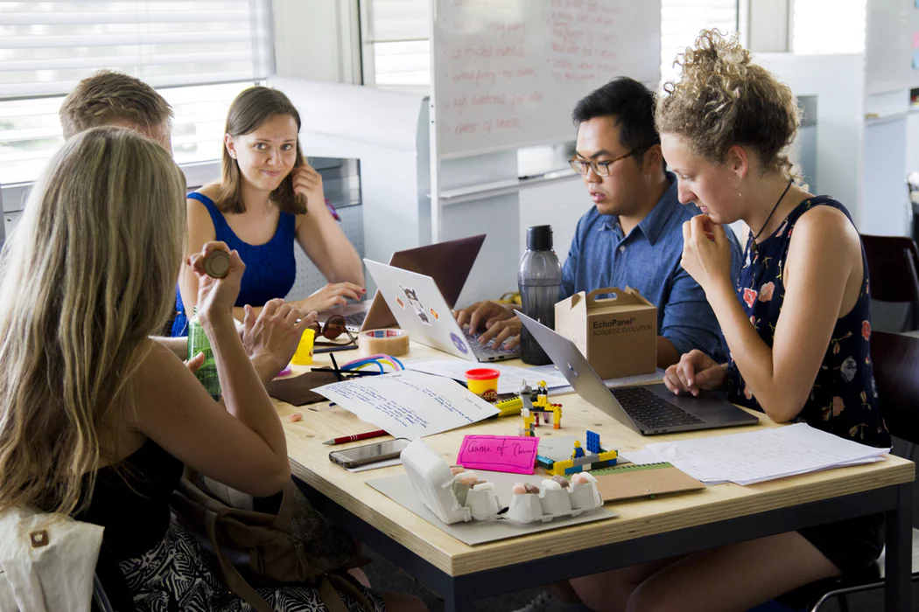
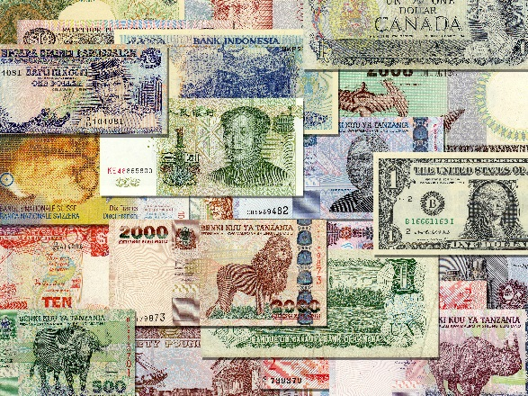
What is this Project About?
W3C intends to marshal the resources of organisations that care about these problems to strengthen internationalisation support on the web
Photo by Climate KIC on Unsplash Shutterstock Image ID: 72752062
Set 3-10 year stretch goals of progress
Measureable progress on language support, author support, developer support
Goals set independently so that we can move faster in areas where we get greater support

Slide 8
Where are We Starting From?
Definition of How Well the Web Currently Supports a Particular Language
We have 27 Criteria that we are Measuring
For the top 72 Languages (initial targets), of which 16 are Indic, we will measure these elements and give the language one of four categorizations:
Advanced – Web Support of high-quality rendering
Basic – Web Supports commonly required features
Minimal – Web readable but missing basic features for the community
Broken – fundamental requirement prevents Web Usage

Slide 9
Where do Indic Languages Stand?

Slide 10
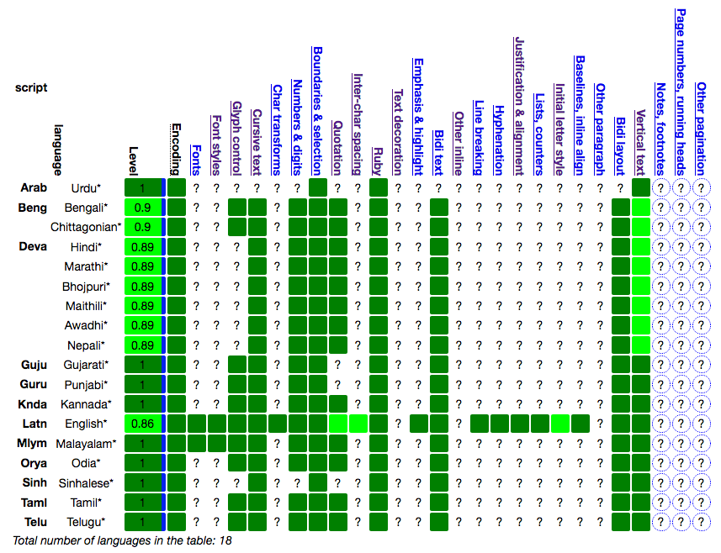
Where do Indic Languages Stand?

Slide 11
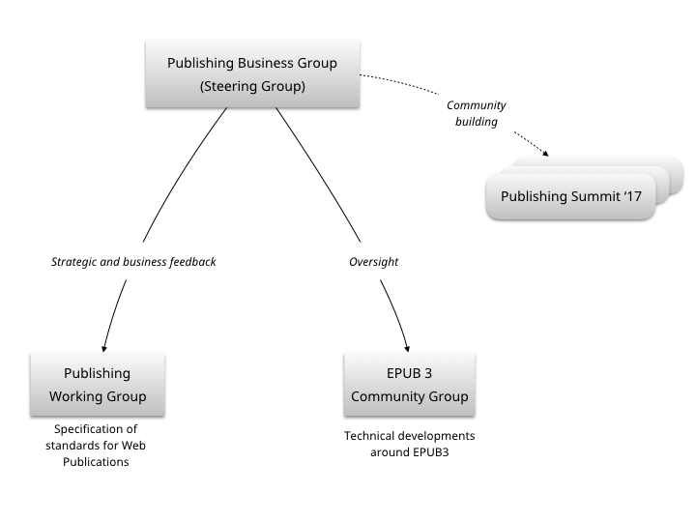

Slide 12
It is the goal of the Publishing Working Group to provide, in concert with other W3C Groups, the necessary technologies on the Open Web Platform to make the combination of traditional publishing and the Web complete in terms of the readers’ needs, portability, distribution, archiving, offline access, or reliable cross referencing.

Slide 13
In short, all publications—with all their specificities and traditions—should become first-class entities on the Web.

Slide 14
Areas for Potential New Work
Accessible Advertising
Advanced features for scholarly/academic/STM
Archival
Color management
Fonts
High quality printing from Web/EPUB directly
Full Support of Indic Languages – let’s add this!

Slide 15
What Does Success Look like?
Completed Gap Analysis on top 10 Languages to Verify They meet Advanced Criteria
Move 6 Indic languages from Basic to Advanced in 3 years
Have 5 organisations join the community as active W3C Members in CY 2018
These objectives require significant W3C Staff increase and plus much increased participation from the Indian Language community

Slide 16
Our Team for This Program
Alolita Sharma – Overall Program Chair
Abhijit Dutta – Co-Chair for In-Country Activities
C-DAC Pune – W3C India Office led my Mahesh Kulkarni, Country Manager
Richard Ishida – W3C Internationalisation Leader
Bill McCoy – W3C Publishing Champion
J. Alan Bird – W3C Global Business Development Ldr

Slide 17
I18N Program Sponsorship Levels
Platinum sponsorship is a commitment of $100 K per year.
Gold sponsorship is a commitment of $50 K per year.
Silver sponsorship is a commitment of $25K per year.
Bronze sponsorship is a commitment of $10K per year.
Each Level has unique benefits from participation on the Leadership Board and earmarking of funds to website branding

Slide 18
EPUB and the overall Open Web Platform are foundations for next-generation publications that are rich, accessible, and cross-device
EPUB 3.1 is well-aligned with overall Web Accessibility initiatives and will continue to evolve and grow in adoption under W3C stewardship
Future Web Publications functionality will further converge online/offline, packaged/distributed paradigms
We want to know more about the needs of everyone in the publishing community – academic and scholarly, educational, libraries, trade, magazines, journals, graphic designers and what’s missing from the Web
Encourage conversations through many avenues: industry associations like BISG, W3C Publishing Summit, 9-10 November 2017, San Francisco

Slide 19
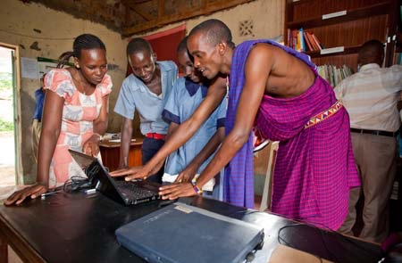
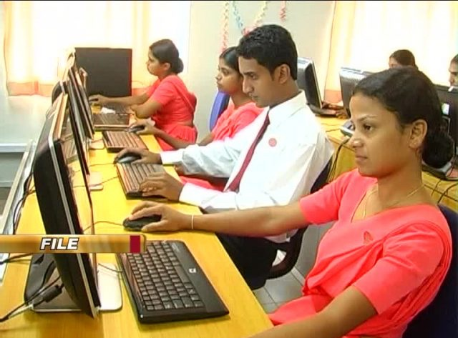
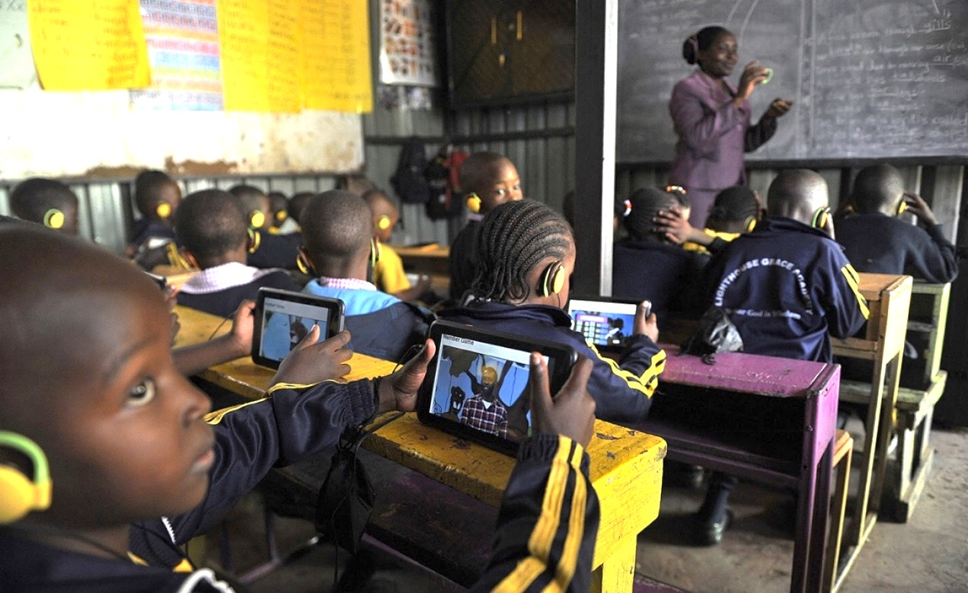
Will You Support Us in this Effort?
The users of the Web need your help!

Slide 20
THANK YOU
FOR YOUR TIME!

