Slide 1
Site and user security concerns for real time content serving
Chris Mejia, IAB
Sean Snider, Yahoo!
Prabhakar Goyal, Microsoft

Slide 2
Agenda
Introduction: what is IAB?
Use case
SafeFrame Overview
HTML5 Sandbox/CSP – Asks
Next Steps and Q&A

Slide 3
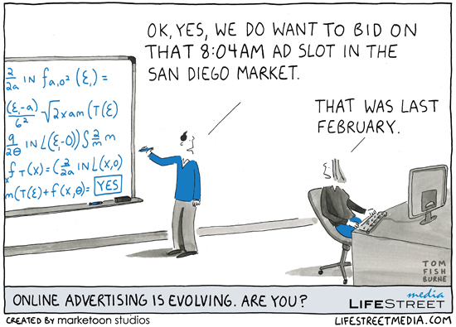

Slide 4
Introduction: what is IAB?
Interactive Advertising Bureau
Membership-based trade organization, based in NYC
Founded in 1996
Members are online media publishers
Over 600 members in the US
86% of digital advertising in US runs on IAB member sites
IAB develops digital advertising & publishing standards
How do our interests align?
Ad content is served from 3rd parties in real time
Publishers are concerned with site and user security
Most Web content is paid for by advertising & sponsorship
We believe in the power of a “free” Web

Slide 5
Use case: Real time content serving
Browser
1
Content request
Publisher Web Server
2
Content
3
Ad Request
Publisher Ad Server
4
To exchange
Agency ad server
6a
RFB
Exchange
5
Ad Request
RFBr
6b
Ad network
Ad
6
RFP
6c
RFPr
6d
DSP
7
Asset Request
CDN
8
Asset

Slide 6
Publisher areas of concerns
Isolation
Separation between publisher and 3rd party code
Prevent data leakage – page content, cookies, other data
Prevent JS and CSS collision
Functional / UI
Allow rich interactions without providing full access
Restrict certain media types
Control autoplay
Ability to control other “attack surface areas”
Prevent downloads
Plugin activation
Navigation
Messaging
..
Covered by Iframe+SafeFrame
Topic of today’s discussion

Slide 7
SafeFrame Overview

Slide 8
What is SafeFrame?
A cross domain IFRAME
Standard definition of APIs between the top level browsing context and the content inside the IFRAME
Said IFRAME MUST be a direct child of the top, it cannot be nested.
API establishes functionality for ‘heavy interactions’ with the top level browsing context:
Expand/Resize the Frame
Draw additional elements
Etc.
Each piece of functionality can be allowed or disallowed by the top level browsing context
API allows for some data sharing
Geometric information
Relevant DOM events
Notes:
SafeFrame communication is built using the fragment identifier or the window.name property “hacks” on older browser

Slide 9
What is SafeFrame?
Host
External Content
SafeFrame APIs
Content Domain
Cross Domain (“agnostic”) IFRAME
for 3rd party content
Creates one or more IFRAME(s) using a Secondary agnostic origin
But content is injected, rather than loaded from a given URL, mitigating the need for an HTTP request per IFRAME.
Typically document URI for the IFRAME is a CDN (content delivery network) URI
Document and it’s initial resources are cacheable
3rd party content is typically free form HTML and JavaScript
Notes:
SafeFrame communication is built using the fragment identifier or the window.name property “hacks” on older browser

Slide 10
How it Works
PubSite.com
SF JavaScript Tag

Slide 11
How it Works
SF-iframe.com
PubSite.com
SF API
SF JavaScript Tag

Slide 12
How it Works
SF-iframe.com
PubSite.com
SF API
SF JavaScript Tag
3rd party content

Slide 13
How it Works
SF-iframe.com
PubSite.com
SF API
SF JavaScript Tag
3rd Party Content

Slide 14
Proposed Extensions

Slide 15
HTML5 Sandbox and CSP
Limitations (as we see it)
Current sandbox attributes/directives are too coarse grain
There are additional areas of control publishers desire
Ask
Enhancement to allow finer controls, i.e., ability to restrict
Individual plug-ins (Sandbox)
Allow / Deny access to a given IFRAME via JavaScript
Downloads
Alternate navigation
Notes:
Disallow certain plugins - Restrict via “object-type”
Disallow certain image types - Restrict via “img-type”
Disallow certain media type - Restrict via “media-type”
Disallow parts of javascript , e.g., Unsafe-eval, unsage-inline
Restrict certain capabilities on only user action?
Fonts?

Slide 16
SafeFrame, Sandbox and CSP
Desired Feature | Covered by HTML5 Sandbox? | Included in by CSP 1.1? | Comments
allow-plugins | No | Yes | HTML 5 sandbox
plugin-types | No | Yes | Support for enabling/disabling specific plugin types
media-types | No | No | Restrict use of certain type of images, audio, video
require-user-initiation | No | No | Prevent autoplay of audio/video without user initiation Prevent navigation without user initiation
Notes:
Disallow certain plugins - Restrict via “plugin-types”
Disallow certain image types - Restrict via “img-types”
Disallow certain media type - Restrict via “media-types”
Disallow parts of javascript , e.g., Unsafe-eval, unsafe-inline
Restrict certain capabilities on only user action?
Fonts?

Slide 17
SafeFrame, Sandbox and CSP
Desired Feature | Covered by HTML5 Sandbox? | Included in by CSP 1.1? | Comments
file-download | No | No* | Rule to allow / disallow using navigation or an iframe to load content that triggers a download
restrict-script | No | No | Javascript in an IFRAME restricted to itself regardless of origin Allow storage/cookie read/write
force-self-nav-top/force-self-nav-new | No | No | Force navigation target to self or new
message-src | No | No | Rule allowing/disallowing x-origin messaging
Notes:
Disallow certain plugins - Restrict via “plugin-types”
Disallow certain image types - Restrict via “img-types”
Disallow certain media type - Restrict via “media-types”
Disallow parts of javascript , e.g., Unsafe-eval, unsafe-inline
Restrict certain capabilities on only user action?
Fonts?

Slide 18
Next Steps
Define details around the proposed extensions (write the spec)
Communicate the proposal to W3C via the established processes - bugzilla items and spec extension draft
Discuss other areas of collaboration

Slide 19
Thank You!
Contacts
Chris Mejia: chris.mejia@iab.net
Sean Snider: ssnider@yahoo-inc.com
Prabhakar Goyal: pgoyal@microsoft.com
References
SafeFrame: http://www.iab.net/safeframe
Digital advertising ecosystem overview: https://www.youtube.com/watch?v=1C0n_9DOlwE

