Slide 1
Lisa Personalisation
http://rawgit.com/ayelet-seeman/coga.personalisation/demo/conactUs.html

Slide 2
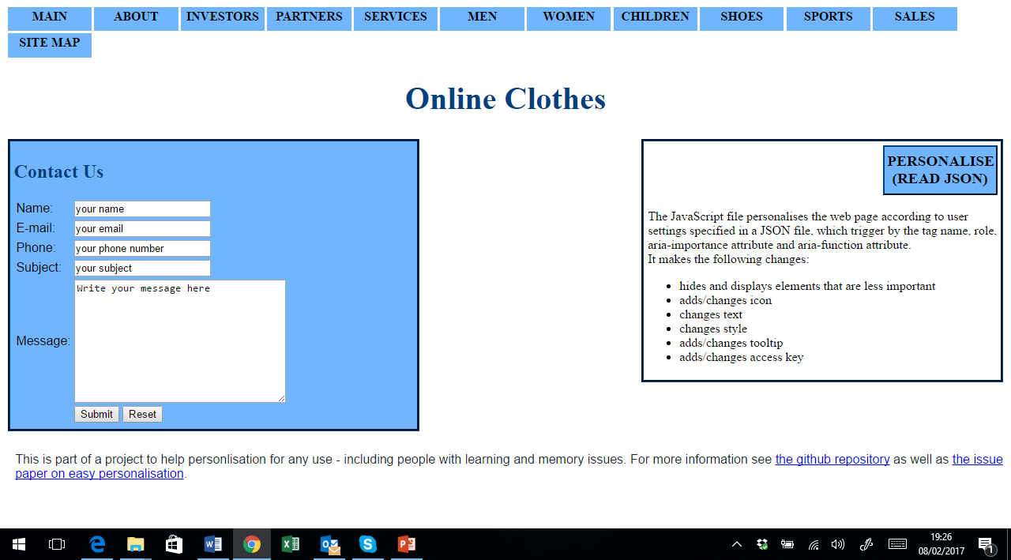
Initial view
Select this area

Slide 3
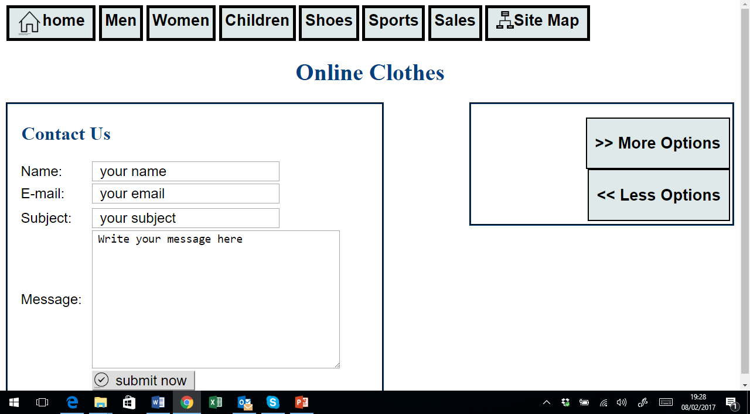
Choose options to personalise
Select this area
Select more or less options to see more or less content

Slide 4
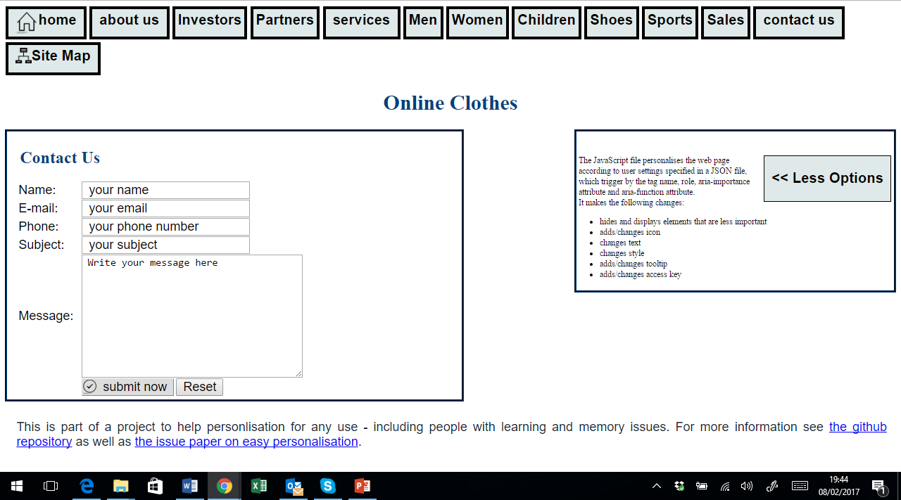
Top amount of content available in enhanced mode
Select this area

Slide 5
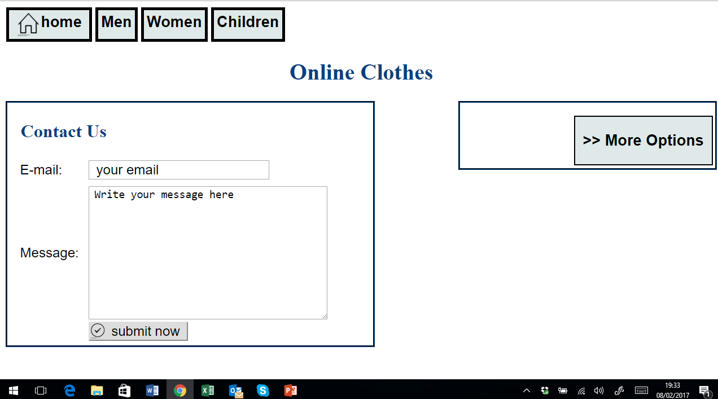
Minimum amount of clutter

