Slide 1
ETSI STF 488
Recommendations to allow people with cognitive disabilities to exploit the potential of mobile technologies
Presented by Mike Pluke for the W3C Cognitive and Learning Disabilities Accessibility Task Force

Slide 2
ETSI, The European Telecommunications Standards Institute

Slide 3
Standardization is …
Sharing efforts and cost
Close co-operation of competitors
Reduction of solutions to a minimum: preferably one!
Creation of a critical mass
Bringing about economies of scale
A fight against technical barriers to trade

Slide 4
Expectations from good standards?
Market relevance
demand by the market, fulfilling market needs
Timely provisioning of
global networking
global interworking
global interoperability
Basis for fair competition
Market growth
Not too detailed, but unambiguous
Detailed enough in order to allow for multi-vendor operation
Usable in different networks

Slide 5
What is ETSI, the European Telecommunications Standards Institute?
One of three European standards organizations (ETSI, CEN, CENELEC)
Officially recognized by the EU & EFTA
Setting globally-applicable standards for telecommunications and related areas
Active in all areas of ICT
An independent, non-profit organization, created in 1988
Offering direct participation of all members
ETSI has more than 15,000 publication available for free!
http://www.etsi.org

Slide 6
What is ETSI?
The home of the GSM standards and a founding partner in:
… and of a lot of others, e.g. ISDN, DECT, DAB, DVB …

Slide 7
Technical Committee Human factors

Slide 8
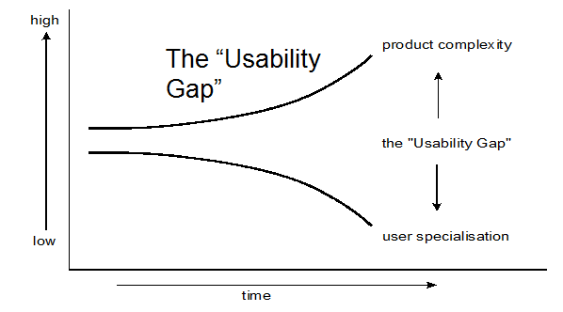
Why should ETSI be interested in Human Factors?
“Featurism” - product complexity increasing
Range of ICT users broadening – children, older, disabled people

Slide 9
ETSI TC HF
Technical Committee – Human Factors
Main scope: usability and accessibility
Formed in 1989
It has produced a very broad mix of guides and standards
For example ....

Slide 10
ETSI TC HF: Examples of Deliverables
European Standards
EN 301 549 “Accessibility requirements suitable for public procurement of ICT products and services in Europe”​
ES 202 076 “Generic spoken command vocabulary for ICT devices and services”
ES 202 130 “User Interfaces; Character repertoires, ordering rules and assignment o the 12-key telephone keypad”​
ES 202 746: “Personalization and User Profile Management; User Profile Preferences and Information”
ES 202 642 “Personalization of eHealth systems by using eHealth user profiles (eHealth)”

Slide 11
ETSI TC HF: Examples of Deliverables
Guides
EG 202 116 “Guidelines for ICT products and services; ‘Design for All’”
EG 202 487 “User experience guidelines; Telecare services (eHealth)”
EG 202 191 “Multimodal interaction, communication and navigation guidelines“
EG 202 848 “Inclusive eServices for all; Optimizing the accessibility and the use of upcoming user-interaction technologies”

Slide 12
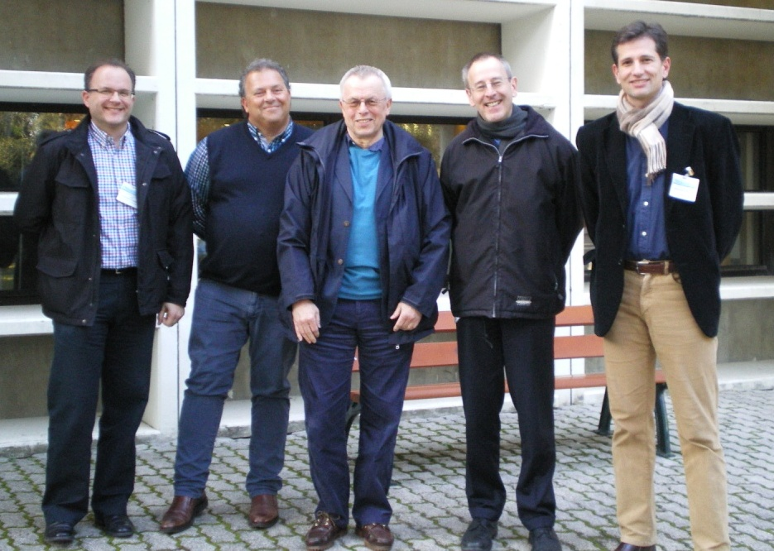
Specialist Task Force (STF) 488
Recommendations to allow people with cognitive disabilities to exploit the potential of mobile technologies

Slide 13
Background to STF 488
Many users with physical or cognitive impairments are challenged when using off-the-shelf devices and services.
ETSI and other standards bodies have in the past offered guidelines for the design of devices and services to make them usable for (almost) everybody.

Slide 14
Background to STF 488
Most of those guidelines focus on the needs of people with sensory or mobility impairments.
There is a need for explicit guidelines for designing for people with cognitive impairments.
ETSI STF 488 “Recommendations to allow people with cognitive disabilities to exploit the potential of mobile technologies” aims at addressing this gap.

Slide 15
Background to STF 488
ETSI STF 488 is a team of experts to produce guidelines for the design of devices and services to also cover the needs of people with cognitive impairments.
The work will result in two documents:
ETSI DEG 203 350
Human Factors (HF);
Recommendations for the design and development of mobile ICT devices and their related applications for people with learning disabilities
ETSI DTR 103 349
Human Factors (HF);
Functional needs of people with learning disabilities when using mobile ICT devices for an improved user experience in mobile ICT devices

Slide 16
ETSI DEG 203 350: Scope
The scope statement of DEG 203 350:
“The present document contains design guidelines for mobile devices and applications that will enable persons with limited cognitive, language and learning abilities (e.g. people with cognitive impairments and older people) to have an improved user experience when using mobile ICT devices and their related applications. The guidelines apply to the design of:
mobile ICT devices;
mobile applications (whether they are standalone or whether they provide access to related services).
The design guidelines are based upon the functional needs of persons with limited cognitive, language and learning abilities described in DTR-00151.”

Slide 17
ETSI DEG 203 350: Contents
The content structure of DEG 203 350:
Introduction
1 Scope
2 References
3 Definitions, symbols and abbreviations6
4 Overview
5 General design issues for mobile ICT
6 Guidelines applicable to any mobile ICT
7 Guidelines specific to mobile ICT with two-way voice communication
8 Guidelines specific to mobile ICT with video capabilities
9 Guidelines specific to hardware of mobile ICT
10 Guidelines specific to mobile Web
11 Guidelines specific to mobile software

Slide 18
ETSI DTR 103 349: Scope
The scope statement of DTR 103 349:
“The present document contains a classification and analysis of ICT needs of persons with limited cognitive, language and learning abilities (e.g. people with cognitive impairments and older people). It describes their functional needs for an improved user experience when using mobile ICT devices and their related applications.
The present document will form the basis for the development of design guidelines for mobile devices and applications that will enable people with cognitive impairments to obtain the maximum benefit from the use of mobile technology.”

Slide 19
ETSI DTR 103 349: Contents
The content structure of DTR 103 349:
Introduction
1 Scope
2 References
3 Definitions, symbols and abbreviations
4 Background and approach
5 Cognitive functions
6 Types of cognitive impairments
7 Classification of user needs when using mobile ICT

Slide 20
Approach of STF 488
Classification of Cognitive Impairments (based on DSM-5 and ICD 10)
Dementia
Depressive Disorders
Anxiety Disorders
Sleep-Wake Disorders
…

Slide 21
Approach of STF 488
Classification of Cognitive Impairments (based on DSM-5 and ICD 10)
Dementia
Depressive Disorders
Anxiety Disorders
Sleep-Wake Disorders
…
Classification of Functioning, Disability and Health (based on ICF)
Orientation functions
Memory functions
Functions of language
Learning
…

Slide 22
Approach of STF 488
Classification of Cognitive Impairments (based on DSM-5 and ICD 10)
Dementia
Depressive Disorders
Anxiety Disorders
Sleep-Wake Disorders
…
Classification of Functioning, Disability and Health (based on ICF)
Orientation functions
Memory functions
Functions of language
Learning
…
Guidelines and Recommendations
Guideline 1
Guideline 2
Guideline 3
Guideline 4
…

Slide 23
Approach of STF 488
Classification of Cognitive Impairments (based on DSM-5 and ICD 10)
DTR 103 349
Dementia
Depressive Disorders
Anxiety Disorders
Sleep-Wake Disorders
…
Classification of Functioning, Disability and Health (based on ICF)
Orientation functions
Memory functions
Functions of language
Learning
…
Guidelines and Recommendations
DEG 203 350
Guideline 1
Guideline 2
Guideline 3
Guideline 4
…

Slide 24
Approach of STF 488
Step 1: Defining the range of cognitive impairments falling under the scope of STF 488
Two recognised classifications of cognitive impairments will be referenced:
The Diagnostic and Statistical Manual of Mental Disorders DSM-5
The International Classification of Diseases and Related Health Problems ICD-10
The subset of disorders to be included in the work of STF 488 is selected on the basis of criteria such as prevalence.

Slide 25
Approach of STF 488
Example of Cognitive Impairments: Unipolar Depression
Definition Major Depressive Disorder
Five or more of the following symptoms during the same 2-week period:
depressed mood,
diminished interest or pleasure in most activities,
significant weight loss or gain,
insomnia or hypersomnia,
psychomotor agitation or retardation,
fatigue or loss of energy,
feelings of worthlessness and / or guilt,
diminished ability to think or concentrate, and
recurrent thoughts of death.

Slide 26
Approach of STF 488
Example of Cognitive Impairments: Unipolar Depression
Major Depressive Disorder (Background, WHO Fact Sheet 369)
Depression is the leading cause of disability worldwide, and is a major contributor to the global burden of disease.
More women are affected by depression than men.
At its worst, depression can lead to suicide.
There are effective treatments for depression.

Slide 27
Approach of STF 488
Example of Cognitive Impairments: Unipolar Depression
The prevalence of Unipolar Depression is high across different regions:
Globally, more than 350 million people of all ages suffer from depression
12-month prevalence of major depressive episode among U.S. adults is 6.9%
The international lifetime prevalence is estimated to be between 16 – 20%.

Slide 28
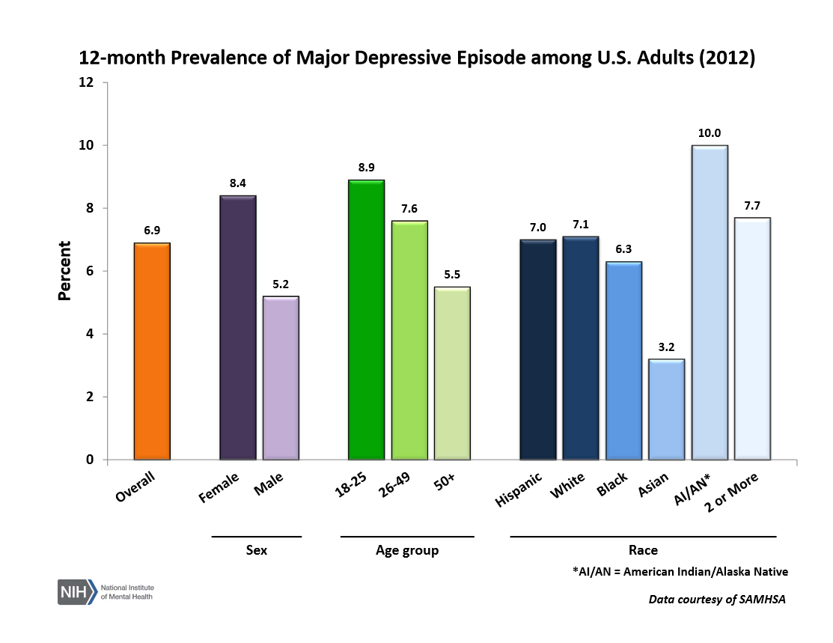
Approach of STF 488
© ETSI 2015. All rights reserved
http://www.nimh.nih.gov/health/statistics/prevalence/major-depression-among-adults.shtml

Slide 29
Approach of STF 488
Step 2: Relating functional requirements to the selected cognitive impairments
The cognitive impairments will be described in terms of ICF functions and activities:
ICF = International Classification of Functioning, Disability and Health
Specific functional requirements will be identified for ICF functions and activities.
This will result in a set of functional requirements for each cognitive impairment.

Slide 30
Approach of STF 488
Examples of ICF functions that can be used to describe Unipolar Depression
Functions:
b1300 Energy level (Mental functions that produce vigour and stamina)
b1301 Motivation (Mental functions that produce the incentive to act; the conscious or unconscious driving force for action)
b1400 Sustaining attention (Mental functions that produce concentration for the period of time required)
Activities:
d160 Focusing attention (Intentionally focusing on specific stimuli, such as by filtering out distracting noises)

Slide 31
Approach of STF 488
Step 3: Developing guidelines for people with specific functional requirements
Guidelines will be developed and published in DEG-HF 0152
for enabling or facilitating the use of mobile technologies by people with specific functional requirements,
regardless of which cognitive impairments the individual function requirements are associated with.
The Guidelines will be collected from existing literature and best practice, or, in the absence of existing recommendations, they will be developed.

Slide 32
To find out more or to get involved
To find out more or to get involved please contact:
Mike Pluke
Castle Consulting Ltd.
Mike.Pluke@castle-consult.com
STF 488 homepage: https://portal.etsi.org/STFs/STF_HomePages/STF488/STF488.asp
Thank you!

