Slide 1
Applying practical experience to HTML5 in Automotive
W3C F2F, 22 April 2013, Barcelona
Andy Gryc

Slide 2
Outline
QNX CAR as an HTML5 proving ground
HTML5 market trends in automotive
The direction this leads us
Examples: old and new
Status of QNX contributions

Slide 3
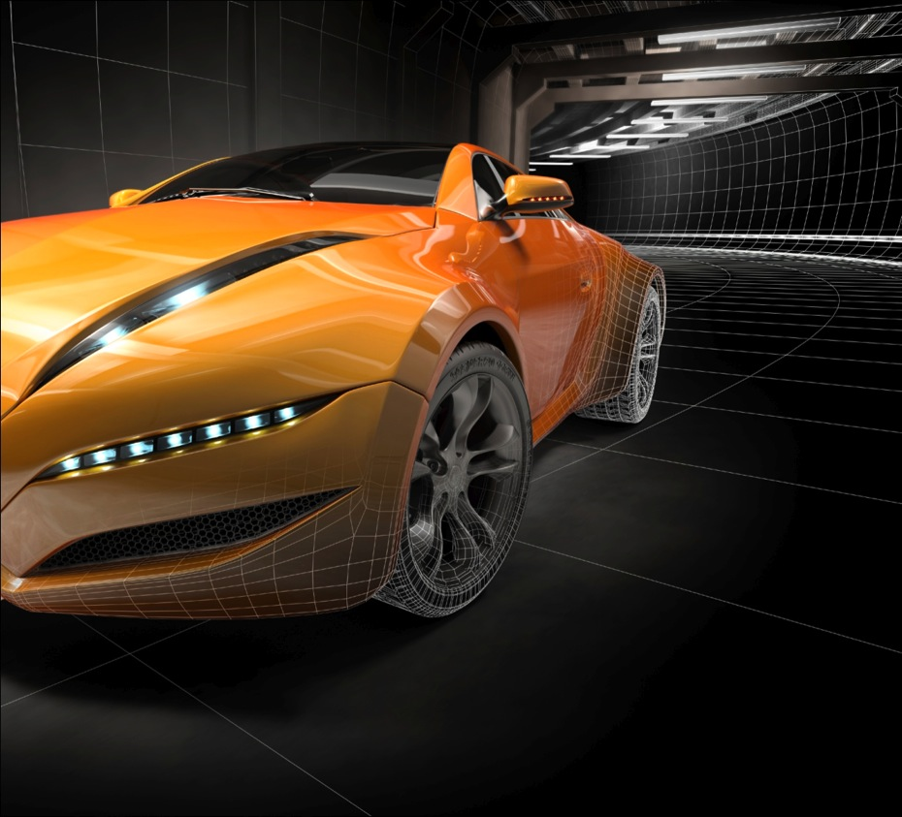
QNX CAR overview
Speed customer’s time-to-market
Leverage HTML5 mobile app development
Leverage consumer electronics speed
Integrate best of breed auto technologies
Solve development and integration issues
Provide customer with flexibility
Support multiple simultaneous HMI frameworks
Fully abstracted component subsystems
12 customers across all major auto regions
North America, Europe, Japan, China
Active work on products & prototypes

Slide 4
Technical lessons learned in applying QNX CAR

Slide 5
Lessons learned in building systems with QNX CAR 2.0
Procedural APIs are convenient, but not complete
Problems: many JavaScript frameworks are built expecting REST; also need way to marshal calls to remote parties (i.e. mobile -> car)
Solution: provide dual APIs, both procedural and REST, whenever practical
Synchronous calls are convenient, but not performance optimal
Problem: JavaScript single-threaded and synchronous calls stall everything for precious milliseconds
Solution: be 100% asynchronous and use callbacks exclusively

Slide 6
Lessons learned in building systems with QNX CAR 2.0, cont.
Must be efficient crossing high latency boundaries
Problem: multiple calls to get all attributes of a component wasteful in terms of interchanges, sending all data is wasteful in terms of bandwidth
Solution: use JSON to request a subset of values in getters, JSON with multiple values in setters
Must design for expansion
Problem: every OEM will want additions or modifications
Solution: provide enumeration whenever possible so callers don’t need to hardcode

Slide 7
HTML5 auto market trends

Slide 8
Overall picture
HTML5 activity still very high
Three main categories of usage
Using it for built-in HMI
Using it for app container environment
Using it for mobile->car integration
HTML5 for car accessing cloud?
Definitely comes up, but not really auto-centric
Can mostly follow existing best practices

Slide 9
HTML5 for built-in HMI
Originally area of great interest by OEMs
Interest here is waning
Performance and memory use not living up to expectations
OEMs won’t leverage developer community for creating built-in HMI
Other environments either going strong (EB), or gaining traction (Qt)
Conclusion
Unlikely that HTML5 will be broadly used to build production HMIs at this time

Slide 10
HTML5 for app environment
Still very high degree of applicability
HTML5 engine provides isolated execution container
Gives OEMs ability to draw on mobile ecosystem
HTML5 is only universal mobile app environment
Mobile apps won’t just come “for free”—need adaptation to car environment
All OEMs have this as an area of interest
Conclusion
Plan for dual mode environment (Native framework for HMI, HTML5 for apps)
If work cannot support the broader mobile developer community, will not matter for automotive

Slide 11
HTML5 for mobile integration
Mobile taking over the head unit: two cases
No head unit: mobile + headless vehicle/telematics gateway
Limited head unit: mobile for apps + head unit with MirrorLink or equivalent for expansion
Has been talked about for a while; just starting to see this trend being realized
Conclusion
Whatever we recommend should be able to trivially migrate between mobile and in-car instantiations

Slide 12
The Three Musts of Automotive HTML5
Must build to run apps, not HMIs (unless HMIs come along for free)
Must build for mobile developers as the target development audience
Must be able to integrate HTML5 environment with native

Slide 13
What is Apache Cordova?
Set of standardized JavaScript APIs for access to native device functionality
Apps developed completely using web technologies (HTML5, CSS and JavaScript) – no native coding
APIs are consistent across multiple platforms (iOS, Android, BB10, Win7)
Promotes a “develop once, target many” philosophy
Content is free and open source under the Apache License, version 2.0
Automotive can leverage mobile app development

Slide 14
The only sensible course

Slide 15
Capitalizing on the lessons
QNX CAR 2.1 is on-going development (QNX CAR 2.0 commercially released January 2013)
Migrating all APIs to be compatible with Cordova
APIs are now integrated into BlackBerry WebWorks
BlackBerry WebWorks in process of being contributed to Cordova
In other words…
QNX CAR 2.1 APIs are becoming part of Apache Cordova

Slide 16
QNX CAR 2.1 API changes
Make QNX CAR a cross-platform target in Apache Cordova
APIs are being converted to meet the Cordova API implementation architecture
Comply with any Cordova APIs that are already in existence today such as audioplayer
Develop Cordova-compliant APIs that are scalable
Architect the APIs to support a superset of automotive system configurations
For example, the HVAC API allows for variable number of climate control zones in vehicles, not just driver and passenger side
Develop APIs that support the shift to mobile
Support applications running locally in the car, and remotely on a mobile phone

Slide 17
HVAC example

Slide 18
QNX CAR 2.0 HVAC
get Returns object with the requested HVAC settings
Parameters:
set Set one or more HVAC settings
Parameters:
HVAC Attributes | Data Type
airCirculation_setting | Boolean
airConditioning_enabled | Boolean
fan_setting_l | Number
fan_setting_r | Number
fan_speed_l | Number
fan_speed_r | Number
fan_temperature_l | Number
fan_temperature_r | Number
heatedSeat_level_l | Number
heatedSeat_level_r | Number
rearDefrost_enabled | Boolean
zoneLink_enabled | Boolean
Name | Type | Description
settings | Array | A list of settings to get [optional]; if this parameter is omitted, all settings are returned
Name | Type | Description
args | Object | The HVAC settings to set
NOTE: the list of settings is not fixed and depends on the specific system configuration

Slide 19
QNX CAR 2.0 HVAC example calls
qnx.hvac.get( airCirculation_setting, airConditioning_enabled, fan_speed_l,...)
Returns:
{ airCirculation_setting: true, // circulate air
airConditioning_enabled: false,
fan_speed_l: 2, // left fan speed value
[...]
}
qnx.hvac.set(fan_setting_l: 3, fan_setting_r: 1, [...] )

Slide 20
HVAC API for Apache Cordova (QNX CAR 2.1)
com.qnx.car.hvac allows users to :
retreive HVAC zones
retreive HVAC settings for a specified filter
save an HVAC setting
Implement APIs using callback functions:
successCallback
errorCallback

Slide 21
Settings and Fan Direction enumerated types

Slide 22
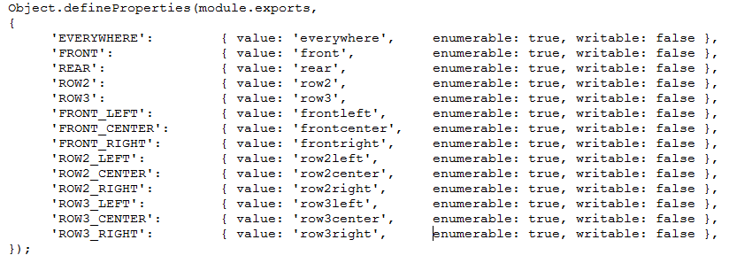
Vehicle Zone enumerated types

Slide 23
Retrieve HVAC settings example
Retrieve HVAC settings:
car.hvac.get(successCb, errorCb, [‘fanSpeed’, ‘heatedSeat’, … ]);
Returns object sent in callback:
{
setting: ‘fanSpeed’ // car.hvac.HvacSetting.FAN_SPEED
zone: ‘everywhere’ // car.zones.Zone.EVERYWHERE
value: 5
}, {
setting: ‘heatedSeat’ // car.hvac.HvacSetting.HEATED_SEAT,
zone: ‘frontleft’ //car.zones.Zone.FRONT_LEFT,
value: 0
}, { … }

Slide 24
HVAC settings example
Save HVAC settings:
car.hvac.set([car.hvac.HvacFanDirection.DEFROST == 'defrost‘], [car.zones.Zones. FRONT_LEFT == ‘frontleft’], value == true, successCB, errorCb);
callbacks optional on setters

Slide 25
Vehicle Sensors example

Slide 26
QNX CAR 2.0 sensors
get Returns object with the current vehicle sensors
Parameters:
Sensor Attributes
brakeFluid_level | engineOil_level | tire_pressure_rl
brake_abs | engineOil_pressure | tire_pressure_rr
brake_abs_fl | engine_rpm | tire_wear_fl
brake_abs_fr | fuel_level | tire_wear_fr
brake_abs_rl | light_head_fl | tire_wear_rl
brake_abs_rr | light_head_fr | tire_wear_rr
brake_wear_fl | light_tail_rl | transmission_clutchWear
brake_wear_fr | light_tail_rr | transmissionFluid_level
brake_wear_rl | speed | transmission_gear
brake_wear_rr | tire_pressure_fl | transmission_temperature
engineCoolant_level | tire_pressure_fr | washerFluid_level
Name | Type | Description
sensors | Array | A list of sensors to get [optional]; if omitted, all sensors are returned

Slide 27
QNX CAR 2.0 sensors example
qnx.sensors.get( speed, tire_pressure_fl, tire_pressure_fr, ...)
Returns:
{
speed: 0,
tire_pressure_fl: 31,
tire_pressure_fr: 31
[...]
}

Slide 28
Vehicle sensor API for Apache Cordova (QNX CAR 2.1)
com.qnx.car.hvac allows users to :
retreives HVAC zones
retreives HVAC settings for a specified filter
saves an HVAC setting
Implement APIs using callback functions:
successCallback
errorCallback

Slide 29
Sensors enumerated types

Slide 30
Retrieve sensor settings example
Retrieve current vehicle sensors:
car.sensors.get(successCb, errorCb, [‘coolantLevel’, ‘transmissionGear’, … ]);
Returns object sent in callback:
{
coolantLevel: 50, // car.sensors.COOLANT_LEVEL
transmissionGear: ‘D’, // car.sensors.TRANSMISSION_GEAR
}

Slide 31
Example using filters
var sensors = [ car.sensors.Sensor.COOLANT_LEVEL, car.sensors.Sensor.COOLANT_TEMERATURE ];
car.sensors.get(successCb, errorCb, sensors);
function successCb(data) {
for (var i in data) {
console log ('sensor: ' + i + '; value=' + data[i]);]
}
}

Slide 32
QNX contributions to W3C

Slide 33
Not there yet: API classes as possible contributions
application | keyboard | phone
application.event | locale | radio
audiomixer | medialibrary | sensors
audioplayer | mediasource | settings
bluetooth | message | theme
bluetooth.pbap | navigation | user
hvac | navigator | voice
info | network | volume

Slide 34
Andy Gryc
agryc@qnx.com

