Slide 1
W3C VISSv2 & Volvo SignalBroker OSS demo
Peter Winzell (VCC) Ulf Björkengren (VCC) Magnus Gunnarsson (Melco) Thomas Gyllin (Melco) Daniel Nylander (Melco)

Slide 2
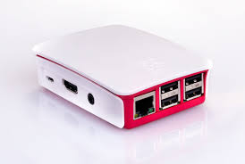
Demo system setup
Client(s)
canplayer
C++
W3C
Server
2.0
Flexray
HTTP
CAN
SignalBroker
Go
gRPC
CAN
WS
LIN
Java
https://github.com/MEAE-GOT/W3C_VehicleSignalInterfaceImpl
https://github.com/volvo-cars/signalbroker-server
https://grpc.io/about/
https://github.com/linux-can/can-utils

