Slide 1
IFSF Limited
Mobile Payment – Pay at Pump
John Carrier, Projects Manager

Slide 2
Architecture Overview
ISO8583Oil
P2F
MPPA
Cloud/WAN
Network
CHP
FEP/ SWITCH
PCI Relevant
Cloud/WAN
Network
ISO8583Oil
P2H
Mobile Data Network
SITES WAN
Network
Card
Acquirer
Vehicle
IFSF FDC to POS
(Web)
ISO8583Oil
H2H
VISS Console
Smart Phone
Dispenser/Calculator
MP
App.
MP
App.
M-PAY
Card
Issuer
Site Computer
Charging
Point 1
Charging
Point 2
M-PAY
POS Terminal
IFSF FDC to POS
(TCP-IP)
Dispenser/Calculator
Sales
Application
Site LAN
POS
Server
FDC
Forecourt Network
Fuelling
Point 1
Fuelling
Point 2
NB: These are Logical Components

Slide 3
Architecture Walkthrough
Important Point
- highly simplified diagram
For example – many missing applications
Sites geo-location database interface
Site Products database
Payments system Sites interface
Payment systems Customer account interface
Loyalty processing and Electronic Loyalty Servers
Security (Certificates/firewalls/encryption/etc.,)
Car parking, Road Tolls, bridges, tunnels and ferries
Car valeting (incl. tyre pressure)
NB: The above list is incomplete
@IFSFonline #IFSFconf2017

Slide 4
Happy Path Walkthrough
Prerequisites
- In order to minimise dialogue
Fuelling pump (i.e. service delivery point) knows where it is
Mobile device (Phone, vehicle tablet) knows where it is
Payment (account) available and default known
Max fuelling amount pre-set (e.g. $50)
All Application WAN and Site LAN networks functioning
Fuelling Pump is Idle (nozzle up) and Ready (zero memory)
Available and required “Product Grades” known
Loyalty Identifier known and enabled
Robotic fuelling and Wireless charging is a not yet available
@IFSFonline #IFSFconf2017

Slide 5
Happy Path Walkthrough
API Summary
- If all goes to plan!!
Three “Success” API Messages
Reserve Fuelling Point
Approve Fuelling Point (following payment Authorisation)
Completed Fuelling Transaction
@IFSFonline #IFSFconf2017

Slide 6
Sad Path Walkthrough
API Summary
- When something goes wrong
95% of transactions follow happy path but….
The sad path can be hugely problematic and difficult to fix
At least 22 “Sad” paths identified and need through testing
Two “Failure” API Messages
Cancel Fuelling Point (to “Un-authorise” a pre-authorised account payment)
Free Fuelling Point (to un-reserve a Fuelling point after a User, Systems or operator intervention/error)
And ”many timers” required – esp. related to connectivity issues
E.g. no Failure message from site
No Approve message to site
How long do you wait??? What length of time for a timer?
@IFSFonline #IFSFconf2017

Slide 7
Alternative Scenarios
Conditions and Exceptions
Conditional Processing
“Digital Offers” redemption (changes unit price or final sale price)
Payment account not pre-configured (dynamically selected/entered)
Acceptable product grade(s) not configured
Location services not enabled – Service Point needs to be uniquely identified
First use (Fire and other safety regulations to be followed)
Local paper receipt required (Trading standards)
Exceptions
Hardware and mechanical failures (including network WAN and LAN)
Pump not free
Insufficient funds in account or account not available
Operator, cashier, customer, vehicle or “system” aborts transaction
Incompatible product / grade selected
@IFSFonline #IFSFconf2017

Slide 8
Misc. Operational Issues
Operational issues
Mixed Service Modes
Cashier needs to know status of the ”Mobile Payment” transaction at all times to reduce “accidental” drive-aways (Fuel is taken yet not paid for)
Fuelling Point must handle nozzle juggling (if not robotic or wireless)
Acceptable product grade(s) not configured
Fuelling point dynamically (i.e. per transaction) sets unit price and ”service mode”)
Alternative Architectures
IFSF has identified 5 real-world working architectures – this one is “winning” because
Site doesn’t require OPT, CRIND or COPT – but does need “unmanned controller device”
No PCI re-certification of site EPS (or any other connected components) is necessary
No PCI relevant data (neither sensitive or personal or private) is required to be transmitted to site
Often referred to as OTA (“over the air” authorisation)
No OIML nor W&M recertification of site equipment / operations needed
@IFSFonline #IFSFconf2017

Slide 9
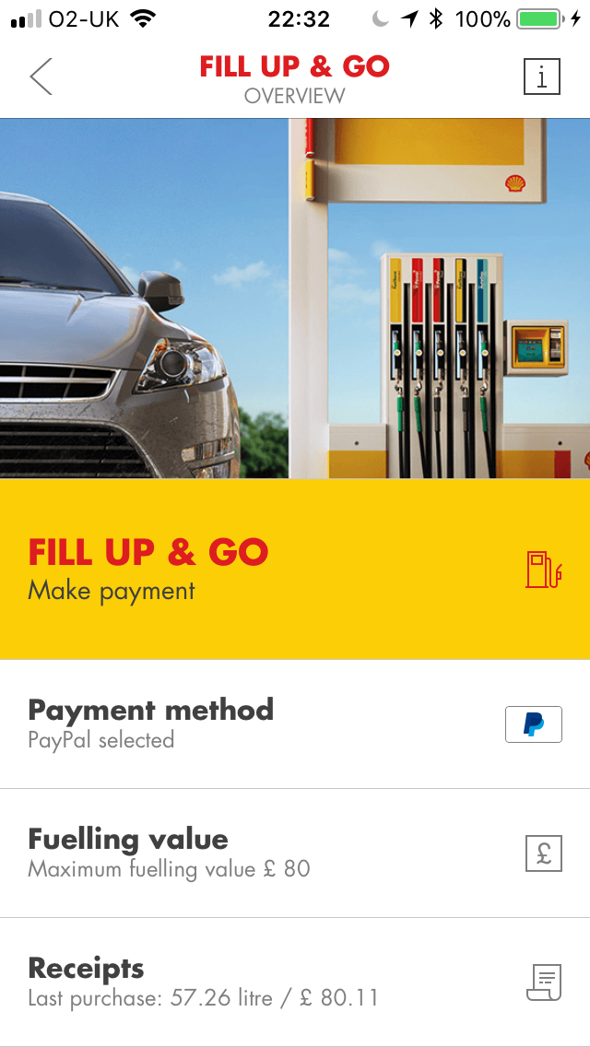
Shell Fill & Go – Happy Path
@IFSFonline #IFSFconf2017

Slide 10
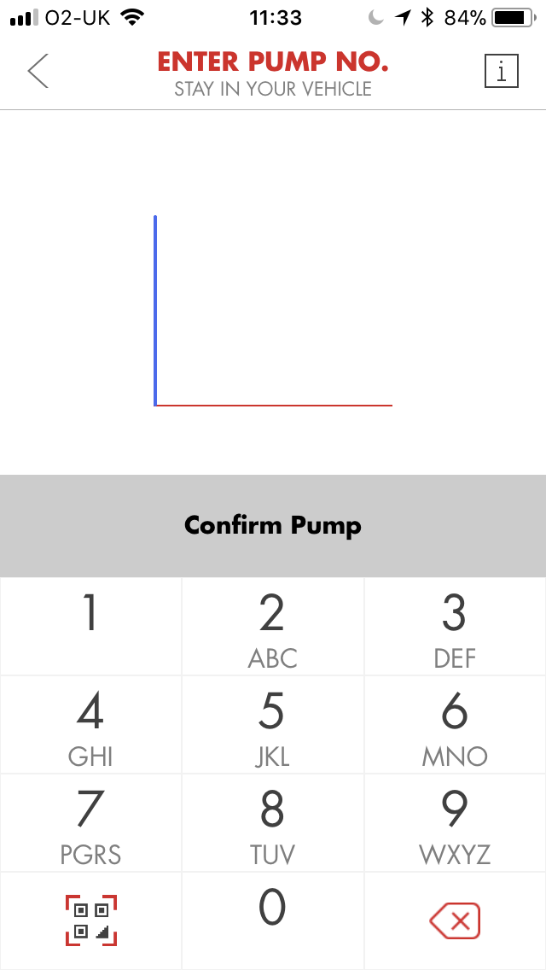
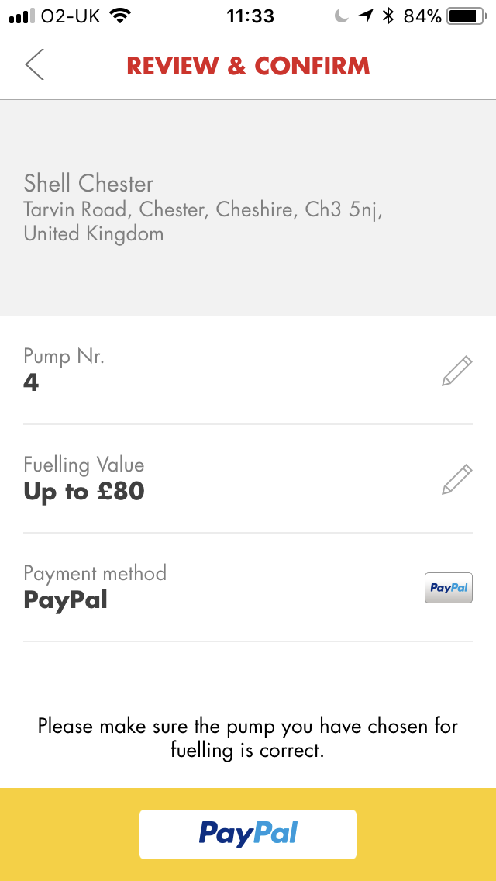
Shell Fill & Go – Happy Path
@IFSFonline #IFSFconf2017

Slide 11
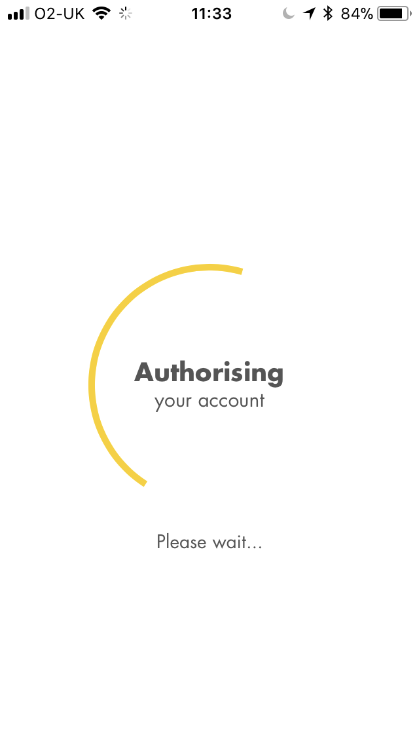
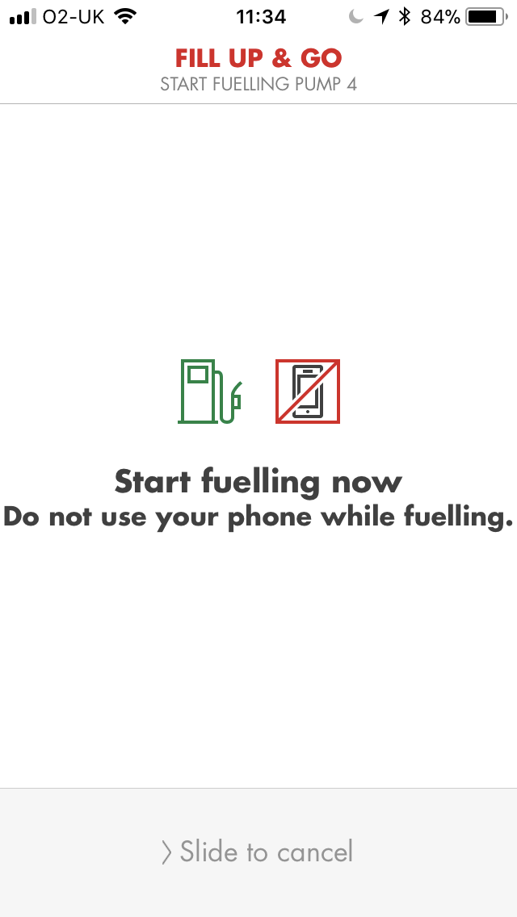
Shell Fill & Go – Happy Path
@IFSFonline #IFSFconf2017

Slide 12
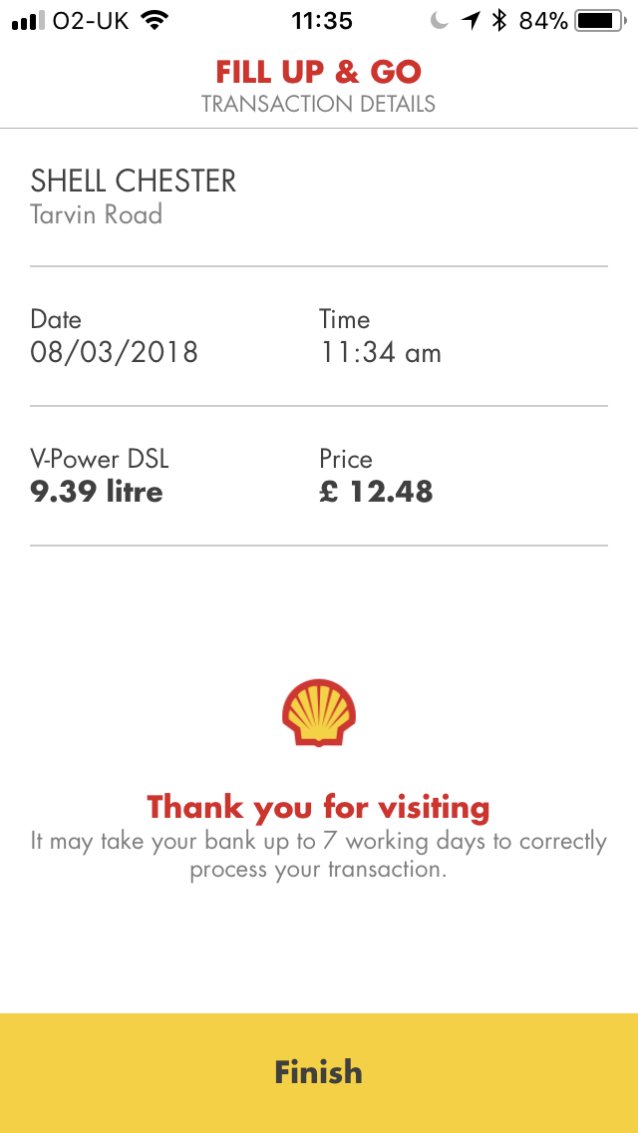
Shell Fill & Go – Happy Path
@IFSFonline #IFSFconf2017

Slide 13
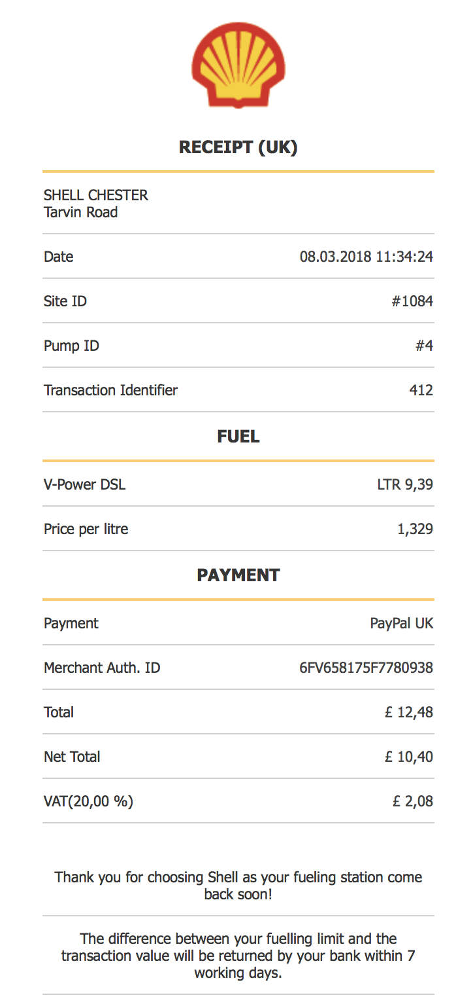
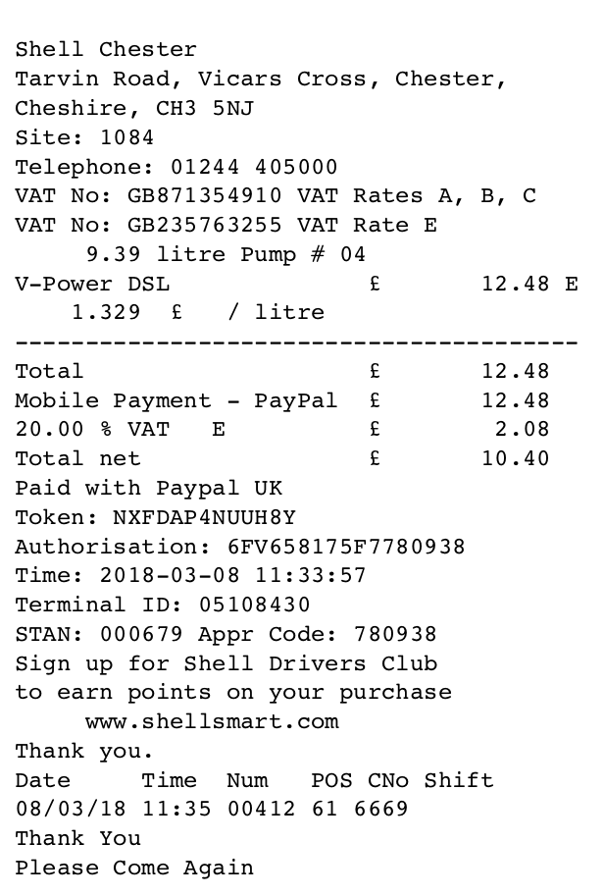
Shell Fill & Go – Happy Path
@IFSFonline #IFSFconf2017

